Slide 1

We Are
Higher Ed HR
Notes:
Welcome to this CUPA-HR Onboarding and Benefits Overview! [offer your personal introductions, connection to the association]
As many of you know, CUPA-HR is the association of and for higher ed HR professionals, and our work focuses on the unique challenges and opportunities of higher ed HR.

Slide 2
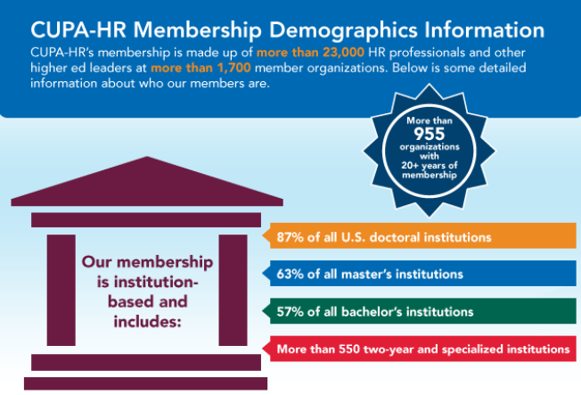
About CUPA-HR
Notes:
CUPA-HR was founded in 1946. The association’s office consists of more than 30 talented team members, who work remotely in locations across the country, along with hundreds of volunteer leaders who give their time to CUPA-HR and the higher ed HR industry. The work of the staff and volunteer leaders is grounded in the association’s values and strategic priorities which can be found on cupahr.org.

Slide 3

Current Focus Areas for CUPA-HR
Leading in Times of Uncertainty
Higher Ed as an Employer of Choice
Employee Health, Well-Being and Safety
Creating and Sustaining Inclusive Communities
Public Policy and Legal Compliance
Effective Use of AI in HR
Notes:
Key areas of focus right now include leading in times of uncertainty, guiding CUPA-HR members toward becoming employers of choice, employee well-being, supporting CUPA-HR members in creating inclusive workplace communities that reflect the values and mission of higher ed, and more.

Slide 4




What CUPA-HR Is Known for …
Comprehensive Higher Ed Workforce Data
Legislative and Regulatory Efforts
Learning Opportunities and Resources
Community of Higher Ed HR Professionals
Notes:
In leading and supporting the work of higher ed in these and other areas, CUPA-HR is best known for:
comprehensive higher ed workforce data (second to none and indispensable to your workforce planning),
legislative and regulatory efforts (bringing higher ed concerns to Congress and bringing federal regulatory and legislative news to you in a higher ed context),
learning opportunities and resources (all designed to help you make an impact in your HR role), and
a community of higher ed HR professionals and the leaders who support them (you won't find it anywhere else)

Slide 5

Today’s Presentation
CUPA-HR Basics
Benefits and
Other Resources
Building Your Professional Network Within CUPA-HR
Tips for Making the Most
of Your Membership
Notes:
In this presentation, we’ll
introduce you to the basics of CUPA-HR membership
give you an overview of resources and benefits available to CUPA-HR members,
explore ways to get involved with CUPA-HR to build your professional network and expand your leadership skills, and
offer some closing tips for getting the most out of your membership.

Slide 6

Membership Basics
Institution-Based Membership
July 1-June 30
Primary Contact
Unlimited Employee Members
Be sure to keep your account profile up to date!
my.cupahr.org
Notes:
First, a little about CUPA-HR membership…
Membership is institution-based, and the membership year runs from July 1 to June 30. Each member institution has a Primary Contact who serves as CUPA-HR's point person for the institution's membership and annual membership renewal.
Individual employees of a member institution are considered members of CUPA-HR if their CUPA-HR account is linked with their institution (you do this when you create your account on the CUPA-HR website). If your account is not linked to your current institution, be sure to contact CUPA-HR for assistance, so you can access all the association has to offer.
Your online profile is where you can make updates to your title, interest areas and more!

Slide 7
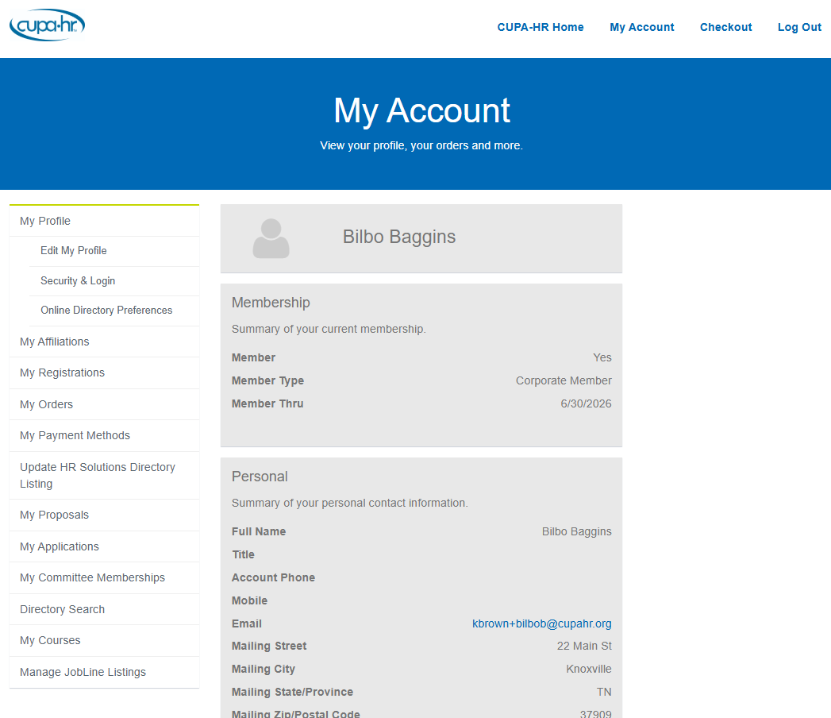
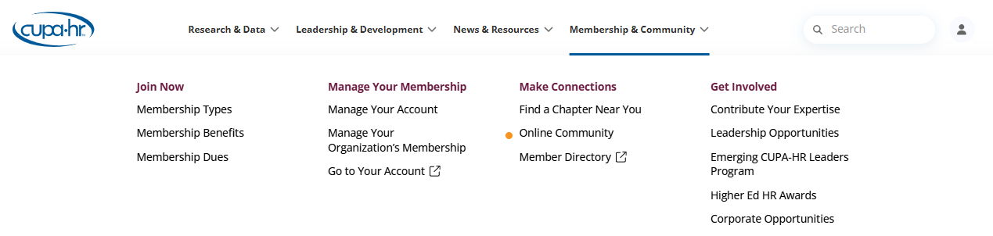
Membership Basics
Your Profile
my.cupahr.org
Notes:
To update your personal profile, visit my.cupahr.org or use the Membership & Community menu to “Go To Your Account”
There you can update your professional title, correct contact information, offer details about your professional history and fill in any demographic information that you’d be willing to share.
You can also review your other CUPA-HR details including past event registrations, product orders, conduct a search of CUPA-HR’s Member Directory and review board, award or committee applications.

Slide 8

Membership Basics
Membership Roles
  Primary Contact
  Chief HR Officer (CHRO)
  DataOnDemand (DOD) Sub-Admin
  Company Managers
  Employee Members
Notes:
Does your organization have a complete roster, with roles assigned to the right individuals?
Primary Contact — This is the individual on your roster who is assigned to be the point person for your membership. They are responsible for keeping your organization’s roster current, and they receive membership updates and renewal information from CUPA-HR throughout the year.
Chief HR Officer (CHRO) — This is your institution’s senior HR professional, the person responsible for leading your institution’s HR team, even if their title doesn’t include “CHRO.”
DataOnDemand (DOD) Sub-Admin — The Primary Contact or CHRO can assign other individuals on the roster to manage their institution’s DOD subscriptions and assign access to those subscriptions. These individuals are DOD Sub-Admins.
Company Managers — Employees on your roster who are designated as Company Managers can manage your organization’s membership roster.
Employee Members — These are the employees who are listed on your organization’s membership roster.

Slide 9
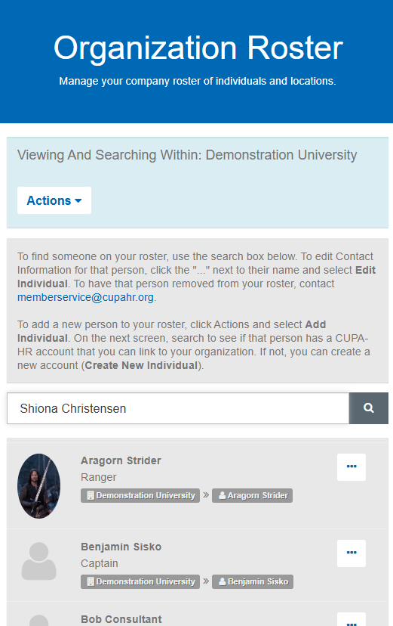
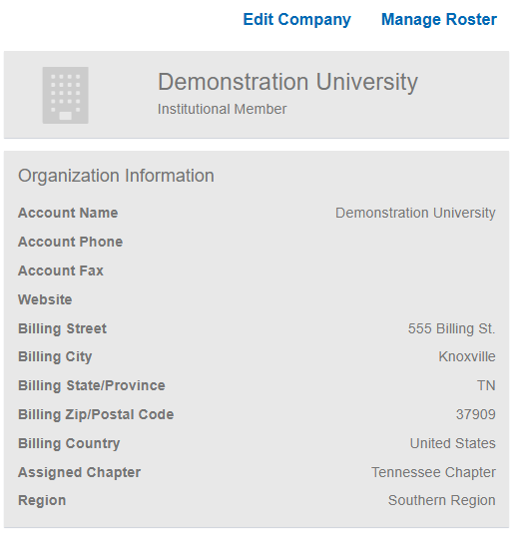
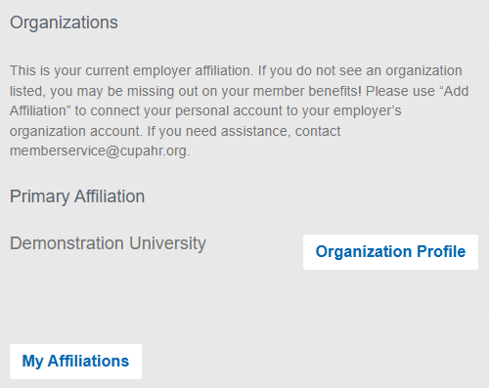
Membership Basics
Roster Management
  Quarterly!
  Add Individuals
Notes:
Bring CUPA-HR benefits to your whole campus by ensuring your roster is full and up-to-date.
Review your roster quarterly. There is no limit to the number of individuals a member institution can add to their roster.
To manage your organization’s roster as a Primary Contact, CHRO or Company Manager, scroll to the “Organizations” section of your personal CUPA-HR profile. Select “Organization Profile”.
On the Organizational Snapshot page, select “Manage Roster”.
First!!! Search for the individual you’d like to add. Your new colleague may have already affiliated themselves with the organization.

Slide 10
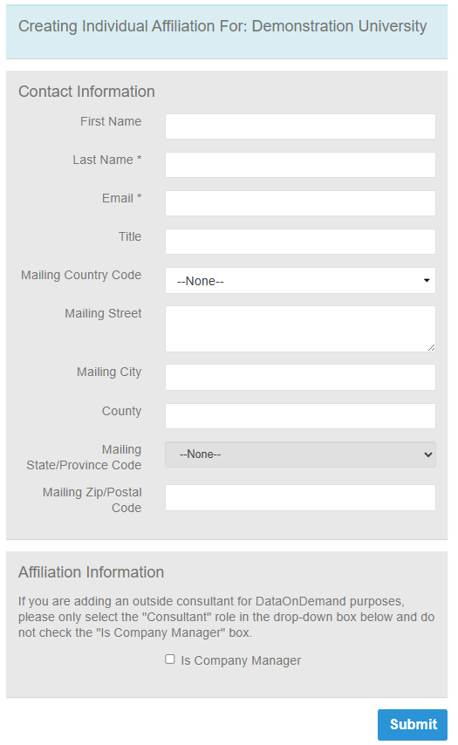
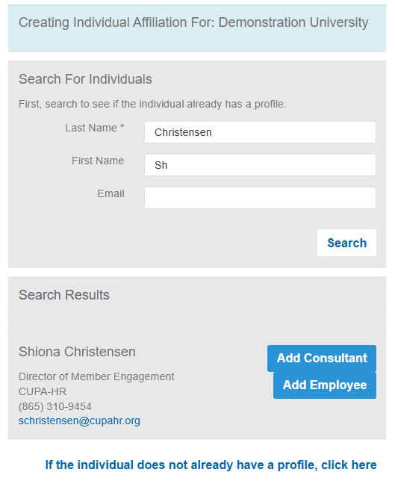
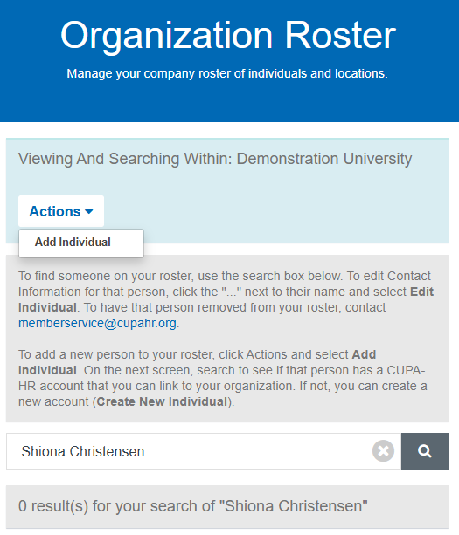
Membership Basics
Roster Management
  Add Individuals
OR
Notes:
If your search yields no results, it’s time to add that individual to your roster!
You’ll want to conduct a new search to find out if the individual already has a profile in our system.
If a profile is found, select “Add Employee” (you will only use “Add Consultant” if you are adding a third-party individual who will be doing consulting for your school and that individual requires access to CUPA-HR’s DataOnDemand subscriptions for your institution).
If no profile is found, follow the instructions at the bottom of the screen to create a new account.
Complete the necessary information on the screen and select Submit. Your new colleague’s account is created and affiliated with your organization so they can begin accessing CUPA-HR member benefits ASAP!

Slide 11

Membership Basics
Roster Management
  Remove Individuals
  memberservice@cupahr.org
Notes:
To remove an individual from your roster, you’ll need to email CUPA-HR directly to make your request.

Slide 12

Member Discounts
$0 Members-Only Webinars!
Event Registration
DataOnDemand (Compare your workforce data with that of hundreds of other higher ed institutions.)
Notes:
CUPA-HR offers members a wide range of benefits… all of which can be accessed on the association’s website.
Discounts
CUPA-HR webinars are complimentary and only available to members!
Member institutions and their employees receive discounts on registration for paid events such as conferences and workshops. (Members saved $255 on registration for our 2025 annual conference.)
Member institutions also receive deeper discounts on DataOnDemand for each CUPA-HR signature survey in which they participate. (Members who participate pay over $800 less for each DataOnDemand subscription than non-participants, and over $400 less than nonmembers who participate in the surveys.)

Slide 13
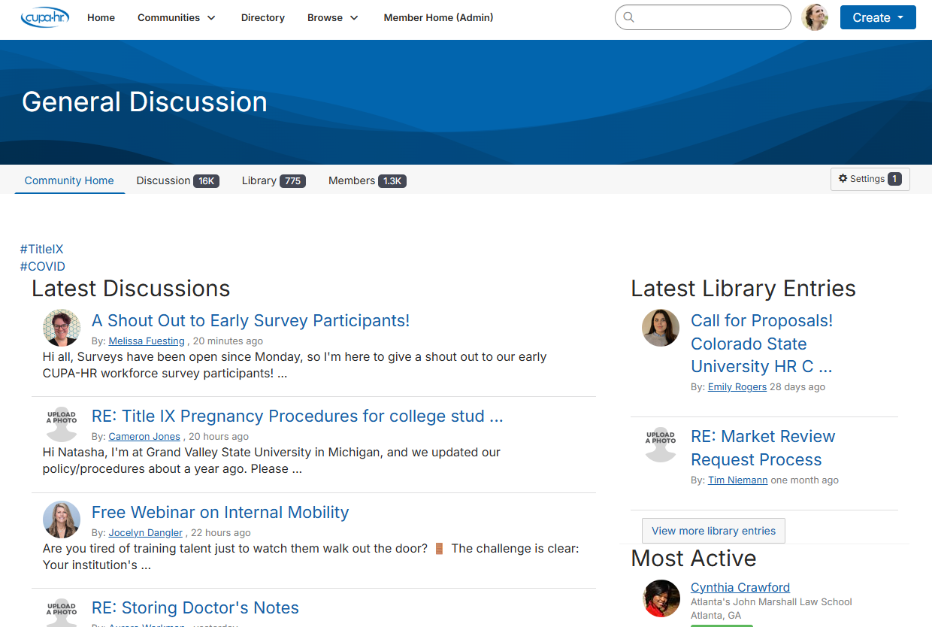
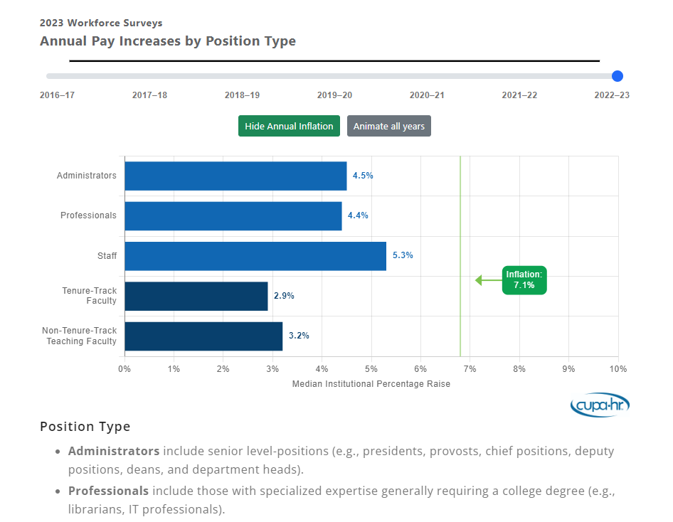
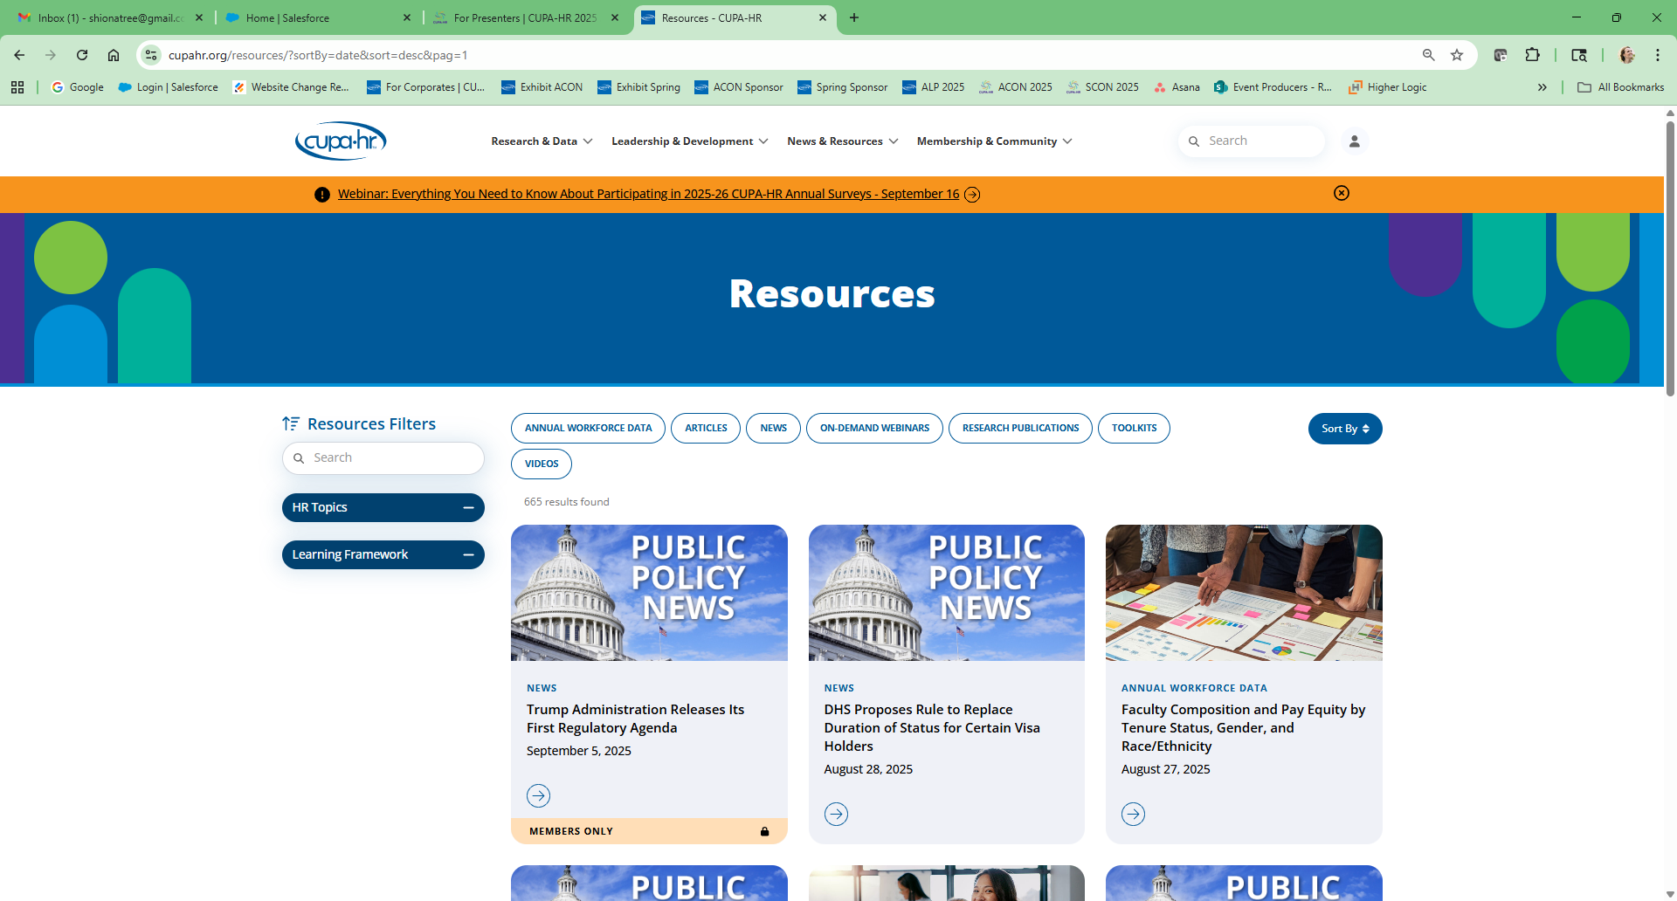
Members-Only Resources
CUPA-HR Connect – Online Community of Members
Research – Members-Only Cuts of the Data
HR Content, Toolkits and Job Description Index
HR-Focused Public Policy Alerts
Notes:
Discounts are great for the bottom line, but the place you’ll find support for your day-to-day work is in CUPA-HR’s members-only resources:
Could you use insight from other higher ed HR professionals to keep a project moving forward? CUPA-HR Connect, an online community, is a great place to tap into the CUPA-HR network. Start with the General Discussion forum, which is open to CUPA-HR members only. If you haven’t already done so, be sure to join the group, select your email preference, and explore the discussion threads.
Not sure where to find benchmark data specific to the higher ed workforce? Research & Data offers a wealth of higher ed workforce data, with special cuts (by institution type, for example) that are available to CUPA-HR members only. For more in-depth data and analysis options, you’ll want to explore the association’s DataOnDemand subscriptions.
When you need sample policies and job descriptions or real-life examples from other institutions, start with the HR Toolkits and Job Description Index in the News & Resources. Both are members-only resources that save you time and effort.
CUPA-HR’s federal legislative and regulatory updates provide clear summaries that you can share to campus leaders. Washington Update Webinars and Washington Insider Alert emails focus specifically on the higher ed implications of proposed changes.

Slide 14
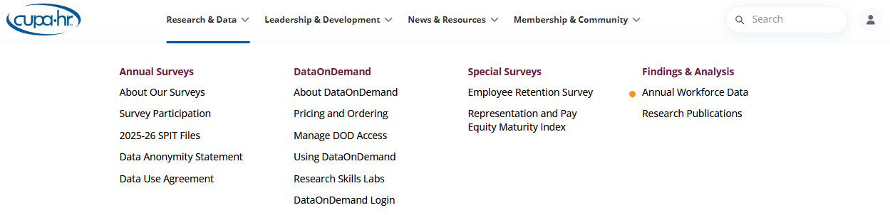
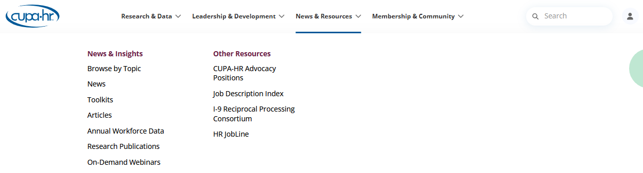
Members-Only Resources
Notes:
And here’s where you can find these resources on the CUPA-HR website.
The link to Connect is in the Membership & Community menu, in the Make Connections section.
CUPA-HR’s Research work has its own section on the site, and you’ll find publications and trend graphics under Findings & Analysis.
News & Resources also has its own section—with Toolkits, Job Descriptions, Articles and more (you can also find CUPA-HR research publications here!).

Slide 15
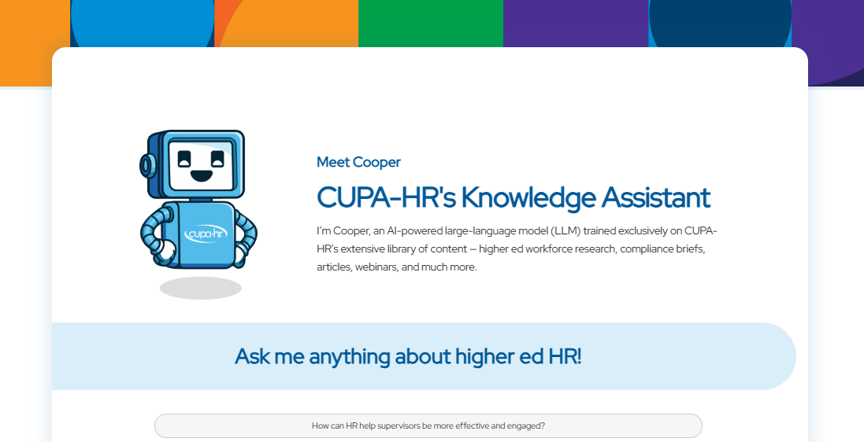
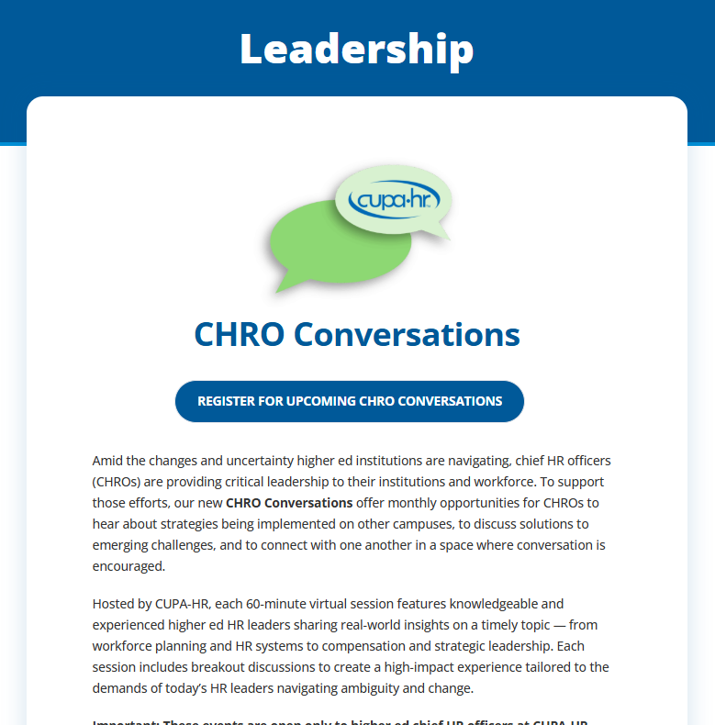
Members-Only Resources
CHRO Conversations
Cooper – AI Knowledge Assistant
Career Growth Series
Notes:
CUPA-HR’s CHRO Conversations. These are FREE monthly opportunities for CHROs to come together and problem-solve, learn and connect. Seats are limited in these sessions, and events are not recorded, so please only register if you plan to attend the live event. Find the latest conversations in Leadership & Development or in CUPA-HR’s Calendar of Events.
Sometimes you don't have time to browse through all those articles, publications and how-tos. That's where CUPA-HR’s AI assistant, Cooper, comes in. Cooper is trained exclusively on CUPA-HR content. Just ask Cooper a question, and it will return a response based on that content and provide links for related CUPA-HR resources.
Later this year, CUPA-HR will launch our new Career Growth Series. Each module will feature a different focus – “Pathways to Leadership, Managers/Supervisors Supporting Employee Career Growth and Leading at Your Institution” - and will consist of three 90-minute virtual workshops presented over the course of several weeks. Just like CHRO Conversations, attendance will be limited and only available to CUPA-HR members. Stay tuned to CUPA-HR’s weekly eNews emails for more details.

Slide 16
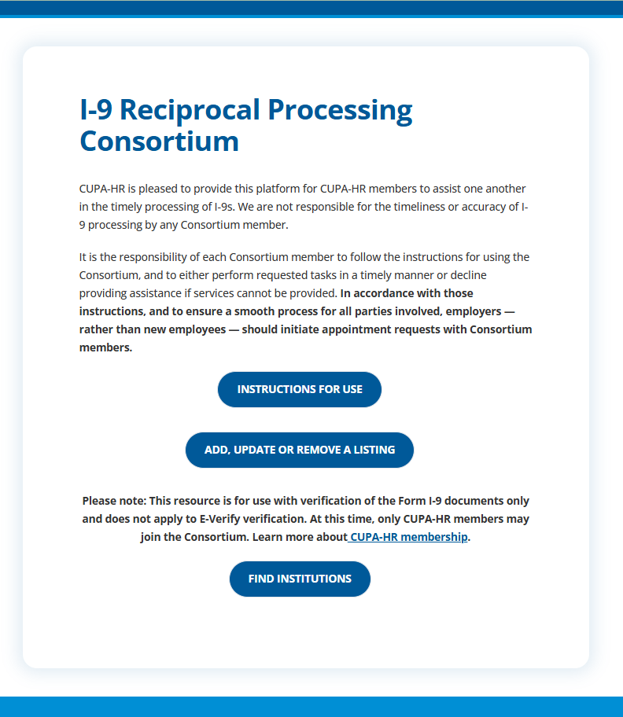
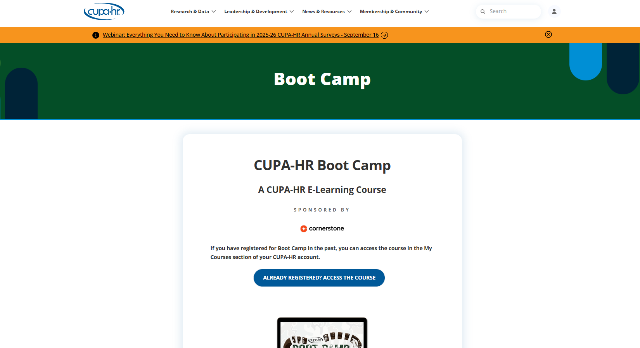
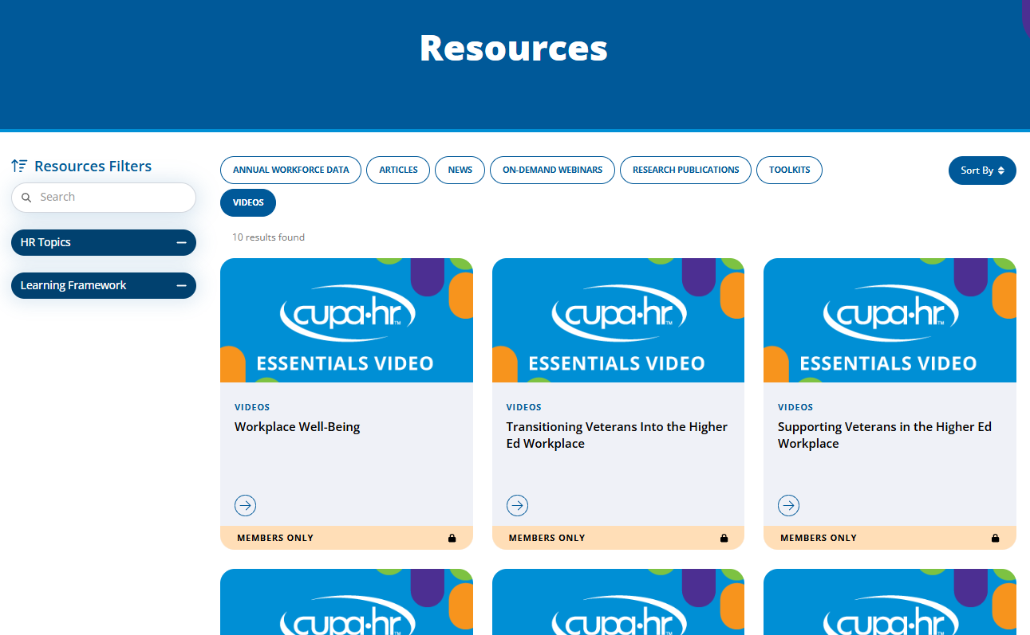
Members-Only Resources
E-Learning Courses
5-Minute Essentials Videos
I-9 Reciprocal Processing Consortium
Notes:
If you’re new to HR or to the higher education workplace — or you just want a refresher — be sure to check out CUPA-HR’s free e-learning courses. The members-only Boot Camp course, which is reviewed and revised annually, offers a higher ed perspective on essential HR topics. The Understanding Higher Education course — also recently updated — serves as an introduction to the higher ed workplace. And be sure to check out Essentials Videos on various topics.
If your workforce includes remote workers in other states, you’ll find the I-9 Reciprocal Processing Consortium an invaluable resource. Consortium participants are CUPA-HR members from across the country who volunteer their services in verifying Form I-9 documents.
All of this content can be found in the News & Resources section on the website.

Slide 17
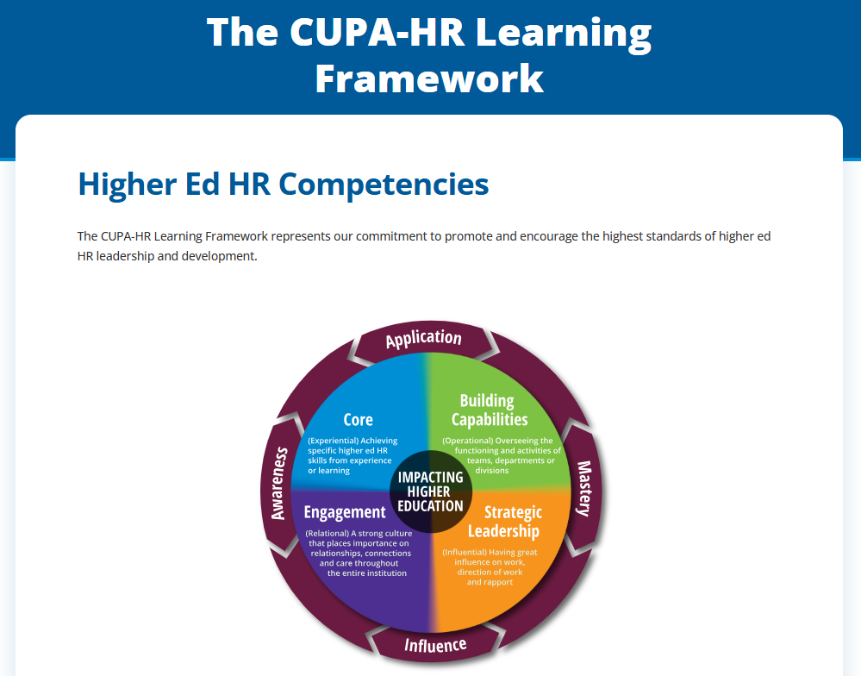
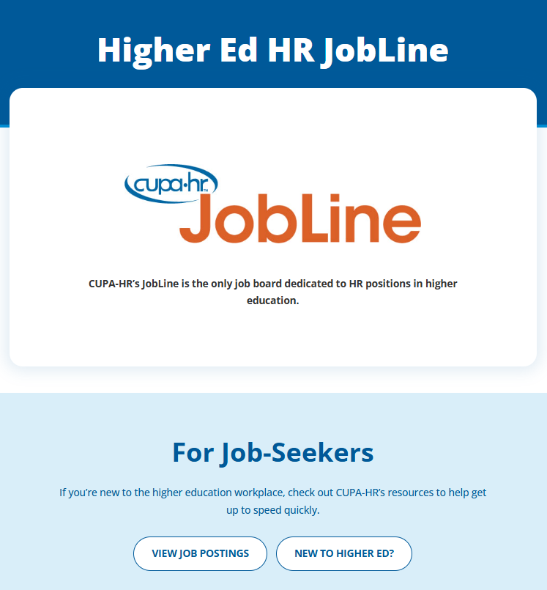
Other Resources
Research Publications
CUPA-HR Learning Framework
JobLine
Long-form Articles
Weekly CUPA-HR eNews
Quarterly Research News
Notes:
CUPA-HR has also developed resources to support the higher education and the higher ed HR profession that are available to anyone:
CUPA-HR’s research team regularly writes research publications analyzing the association’s workforce data and interactive graphics that display data trends.
The Learning Framework — found in the Leadership & Development menu— outlines higher ed HR competencies with detailed examples.
CUPA-HR JobLine is a higher ed HR job board available to both job seekers and employers.
A number of articles found in CUPA-HR’s News & Resources are accessible to anyone!
The weekly CUPA-HR eNews email alerts readers to upcoming events and new resources.
The quarterly Research News email summarizes CUPA-HR’s latest research publications and findings.

Slide 18
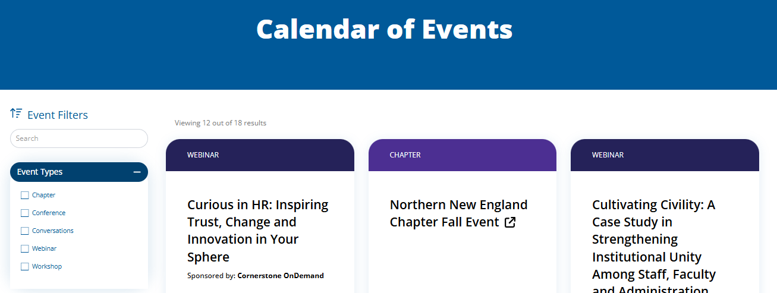
Upcoming Events
Calendar of Events
In Person: Annual Conference, Spring Conference, Chapter Events
Virtual: Free Webinars, CHRO Conversations, Career Growth Series, Higher Ed HR Accelerator, Chapter Events, Research Skills Labs
Notes:
Speaking of upcoming events, be sure to check out the Calendar of Events and eNews regularly! Many CUPA-HR programs qualify for continuing education credits, and all focus on topics and solutions unique to higher ed HR.
I hope at least once a year, you’re able to take advantage of a conference that lets you network in person with peers from your state or across the country! CUPA-HR’s in-person events include an Annual Conference in the fall, a Spring Conference, and many Chapter Events.
For those times when you can’t get away from the office, CUPA-HR offers several virtual events, including Webinars, regular CHRO Conversations, the new Career Growth Series and virtual Chapter Events. The association also hosts a virtual Higher Ed HR Accelerator, often in the winter.
And for those of you who purchase DataOnDemand annual subscriptions, CUPA-HR’s research team leads monthly small-group virtual labs that offer hands-on guidance for extracting the data you need.

Slide 19
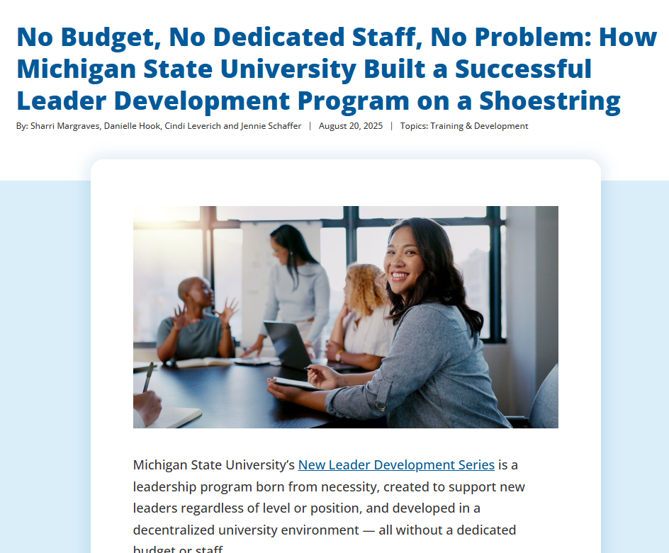
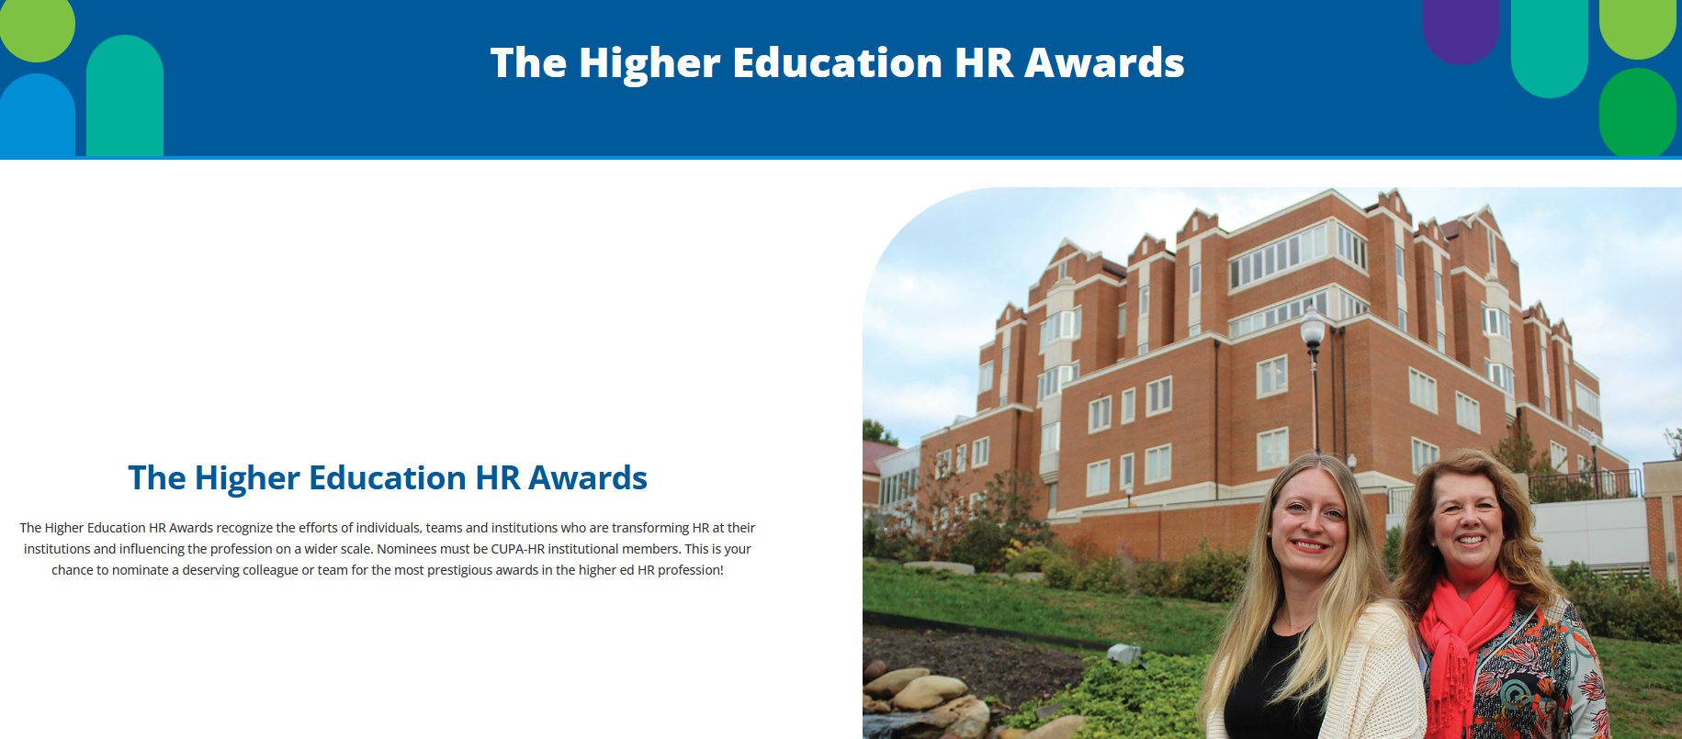
Share the Work You’re Doing
Conference Presentations
Articles
Higher Education HR Awards
Notes:
So far we’ve looked at member benefits and the many resources you can access to support you in your work.
Now I’d like to shift gears and talk more about the important work you do.
At CUPA-HR conferences, in the online community, and through conversations with CUPA-HR members, we hear about so much incredible work being done at institutions across the country. In fact, one of the things that sets CUPA-HR members apart from members of other HR organizations is their incredible generosity when it comes to sharing insights and guidance with one another.
If you’re creating programs and systems to address changing needs on your campus, we encourage you to share your successes with your CUPA-HR peers by submitting a presentation proposal for a conference or an article outline for the CUPA-HR website.
CUPA-HR members are also eligible to be nominated for Higher Education HR Awards, which offer recognition and, in several cases, a monetary contribution made in honor of the recipient to the fund of their choosing at their institution.

Slide 20

Leadership Opportunities
Board of Directors
Chapter Boards (41)
Councils and Committees
2025-26 Board of Directors
Notes:
We also encourage you to get involved with CUPA-HR and advance the higher ed HR profession through one of our many leadership opportunities.
CUPA-HR has a board of directors, composed of higher ed HR leaders from a wide range of institution types. This is a working board that actively sets priorities and helps the association influence important opportunities and challenges for higher ed HR professionals and the higher ed workforce.

Slide 21









































Notes:
Each of our 41 chapters has a board of directors local to their chapter area …

Slide 22

Councils, Committees, Career Growth
Chapter Support Council
Member Engagement Council
Learning and Professional Development Committee
Public Policy Committee
Creating Inclusive Communities Steering Committee
Research Advisory Committee
2025-26 Ignite Cohort
Notes:
CUPA-HR’s committees and councils support the wide-ranging work of the association, whether it’s supporting chapter boards as a member of the Chapter Support Council, increasing member involvement as part of the Member Engagement Council, or driving event content, inclusive communities work, public policy positions and guiding the advancement of CUPA-HR’s research work.
The association is always looking for fresh perspectives to support the work of the association. To express your own interest in serving, visit the CUPA-HR website and complete the Volunteer Interest Form found under the “Get Involved” section of the Membership and Community menu.
In addition to board, committee and council opportunities, CUPA-HR offers a year-long cohort-based leadership development program for our early-career higher ed HR professionals called Ignite. Applications for the Ignite program are accepted annually in January.
Only HR professionals at CUPA-HR member institutions can serve in leadership roles or participate in our career development programs.

Slide 23

Make the Most of Your Membership
Explore the website: www.cupahr.org.
Create an account if you don’t have one.
Look for the weekly eNews email on Wednesdays.
Join the General Discussion forum in CUPA-HR Connect.
Review your member profile periodically.
Notes:
Before we wrap up today’s presentation, we’d like to share a few tips for making the most of your membership and member resources.
Explore the website. It’s packed with resources and information.
If you’re new to CUPA-HR, make sure you have an account (or create one on the website) and know your log-in credentials.
If you log in and can't access members-only resources, contact CUPA-HR!
Make sure you're receiving the weekly eNews — it summarizes the latest news and information, highlights popular resources, and includes a list of upcoming events. Sometimes this means setting us up as a “safe sender” through your institution’s IT systems.
Join the General Discussion in CUPA-HR Connect. It only takes a minute. And while you’re there, check out the other discussion forums.
Be sure to review your profile periodically to make sure it’s accurate.

Slide 24
Thank You!
memberservice@cupahr.org
Notes:
Thank you so much for giving us a bit of your time today.
If you saw a resource you’d like to learn more about, drop it in the chat (or reach out to one of us directly) and we’ll expand upon is as we can, or reach out to CUPA-HR at memberservice@cupahr.org for more detailed follow-up.
Have a great day!

