Slide 1
Advocacy 101
Presenter
Date

Slide 2
CUPA-HR’s Focus on Advocacy

Slide 3
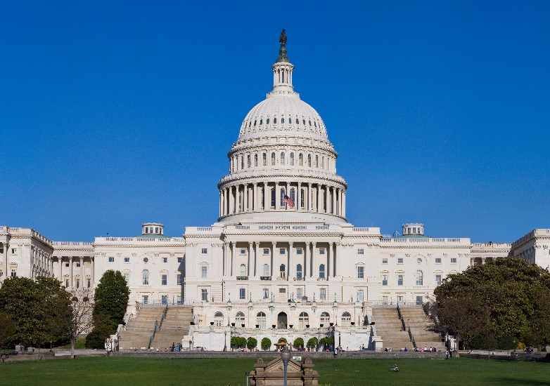
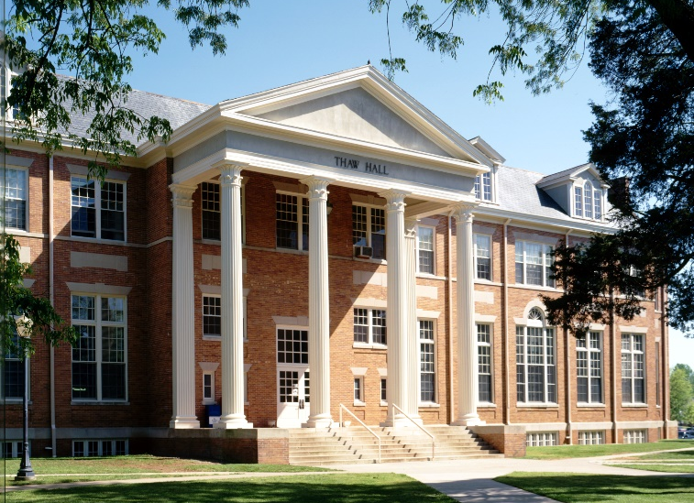
CUPA-HR’s Advocacy Work
Government Relations Team
Public Policy Committee

Slide 4
Anatomy of Advocacy
Higher Ed Friends
Presidential Associations
ACE, AAU, APLU, NIACU, AASCU
Professional Associations
NACUBO, EDUCAUSE, NCCA, etc.
Institutions
Chancellors & Provosts
Government Affairs Officers
HR Officers
Employer (HR) Friends
Employer Associations
SHRM, HR Policy Association, AH&LA, NAM, NRF, Chamber of Commerce
Individual Employers
Business Owners & CEOs
Lobbyists
HR and other officers

Slide 5
How It Works
V
O
L
U
N
T
E
E
R
S

Slide 6
How to Advocate on Your Campus
Talk with your peers
Build relationships with your Government Affairs office
Share CUPA-HR emails with your chancellors and provosts
Review the Advocacy section of the CUPA-HR website: www.cupahr.org/advocacy

Slide 7
State and Local Advocacy
Find out which bills your local senators and representatives sponsor and support
Find out which legislators serve on higher ed or personnel/employment committees in your state
Look for bills in those committees that interest you
Keep informed about local laws that impact your work
http://www.ncsl.org/research/telecommunications-and-information-technology/bill-tracking-and-subscription-services.aspx

