Slide 1
Introduction to the CUPA-HR Learning Framework
Notes:
[30 seconds]
Introduce presenter(s).
[NEXT SLIDE]

Slide 2
Agenda
Introduction to the Framework
The Framework Site
Examples for Use
Notes:
[30 seconds]
[Review agenda on slide]
[NEXT SLIDE]

Slide 3
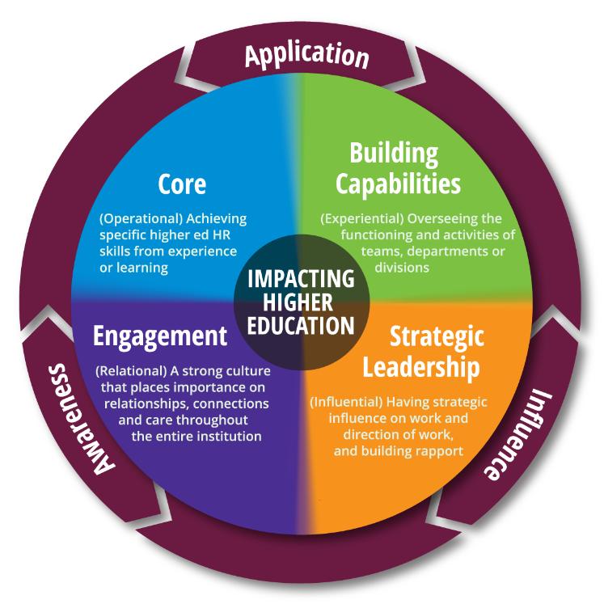
Introduction to the Framework: What Is It?
A tool for assessment
A guide for development
A foundation for success
Notes:
[2 minutes]
The CUPA-HR Learning Framework is designed to provide a foundation for understanding and cultivating the knowledge, skills and behaviors essential to success in higher ed HR. The Framework can be used to assess current abilities, identify skill or knowledge gaps or as a supporting guide for professional growth.
The Learning Framework is not intended to replace performance management discussions. Rather it is designed to bring attention to the work already being accomplished and where opportunities for development might exist.
Since its inception in 2013, the Framework has continued to evolve, with the latest iteration incorporating significant updates that make the Framework even more useful for both individuals and teams.
[NEXT SLIDE]

Slide 4
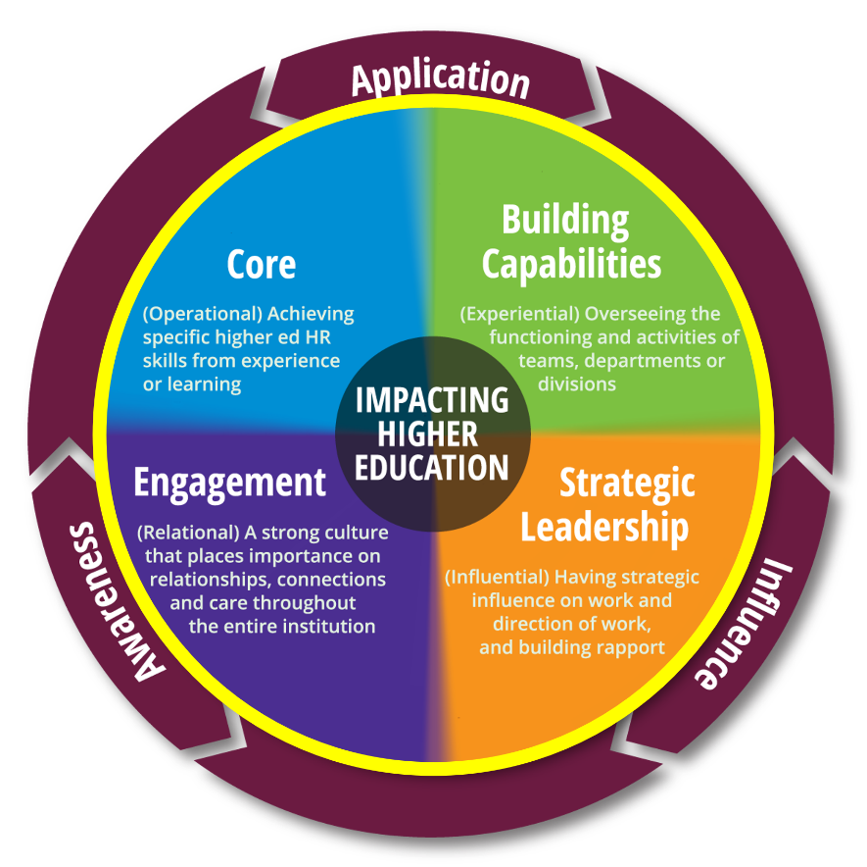
Introduction to the Framework: Main Areas
Notes:
[1 minute]
The CUPA-HR Learning Framework includes four main areas
[Click to highlight Framework Areas on image]
- Core, Building Capabilities, Strategic Leadership, and Engagement.
The Core area includes those skills which are fundamental to the work of higher ed HR practitioners. These competencies included in this area are operational in nature.
The Building Capabilities area focuses on overseeing the functioning and activities of teams, departments or divisions. Competencies in this area are experiential – meaning they are achieved through experience or learning. in nature.
The Engagement area contains those skills and competencies which are relational and highlight the importance of the partnerships we build within higher ed HR.
The Strategic Leadership area focuses on the competencies which allow HR to be influential leaders by strategically contributing to and helping to guide the work of an institution.
[NEXT SLIDE]

Slide 5
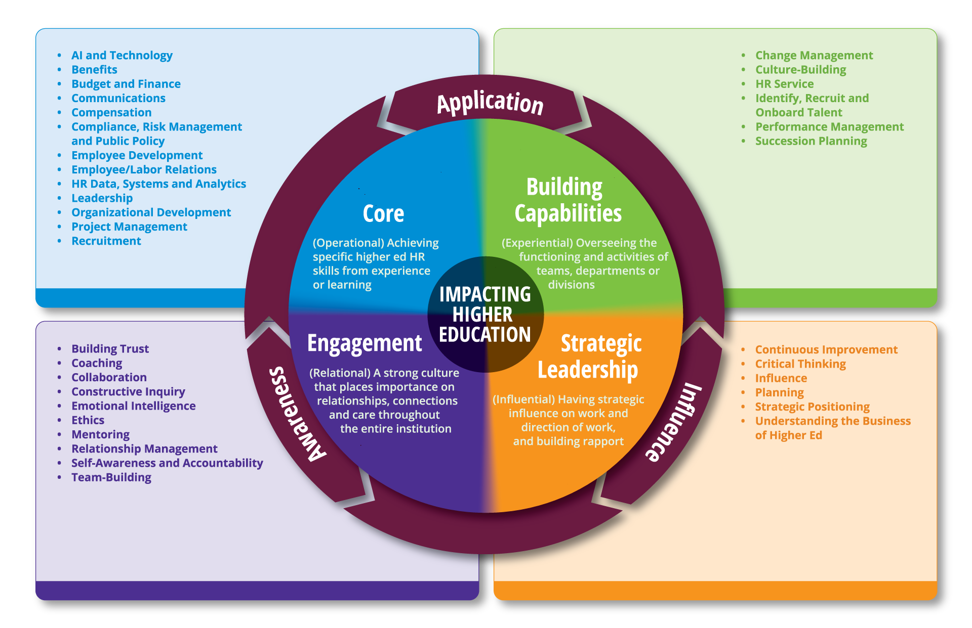
Introduction to the Framework: Competencies
Notes:
[30 Seconds]
Each main area is further composed of a list of skills, knowledge, abilities and behaviors identified as essential to that Framework area.
[NEXT SLIDE]

Slide 6
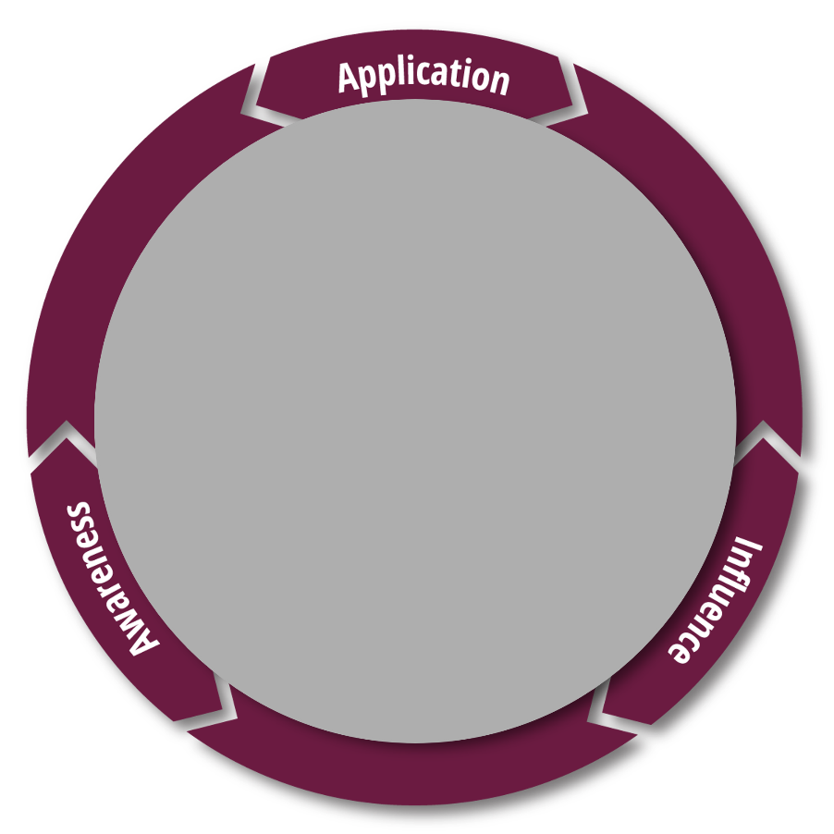
Introduction to the Framework: Proficiency Levels
Notes:
[1 minute]
On the outside of the Framework are three proficiency levels
[Click to highlight proficiency levels on image]
- Awareness, Application, and Influence. These proficiency levels apply across all Framework areas and competencies
Awareness is the ability to recognize the common knowledge or understanding of a competency.
Application is the ability to successfully complete tasks as requested and without assistance. Occasionally, the individual initiates action or makes rudimentary improvements without being prompted.
Influence is the ability to spark change in actions, behavior, processes and relationships to achieve a common goal.
[NEXT SLIDE]

Slide 7
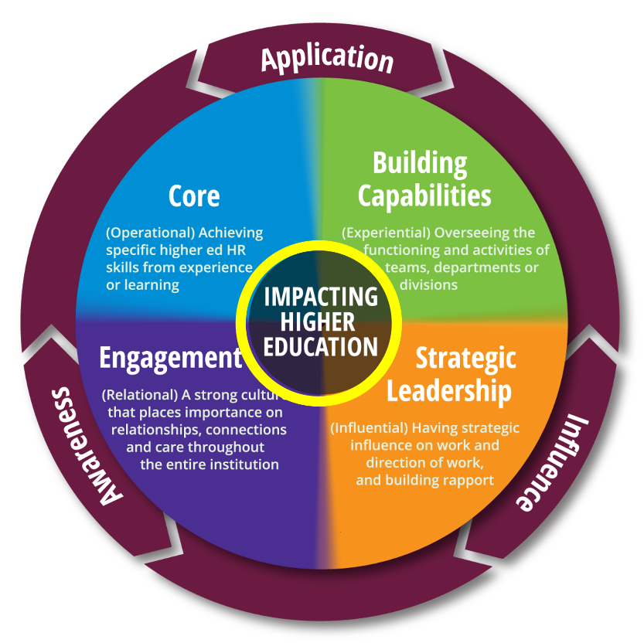
Introduction to the Framework: The Center
Notes:
[30 seconds]
At the very center of the Learning Framework is “Impacting Higher Education”
[Click to highlight “Impacting Higher Education” on image]
- an acknowledgement that impacting higher education is central to not only how we approach our work, but also who we become as institutional influencers.
[NEXT SLIDE]

Slide 8
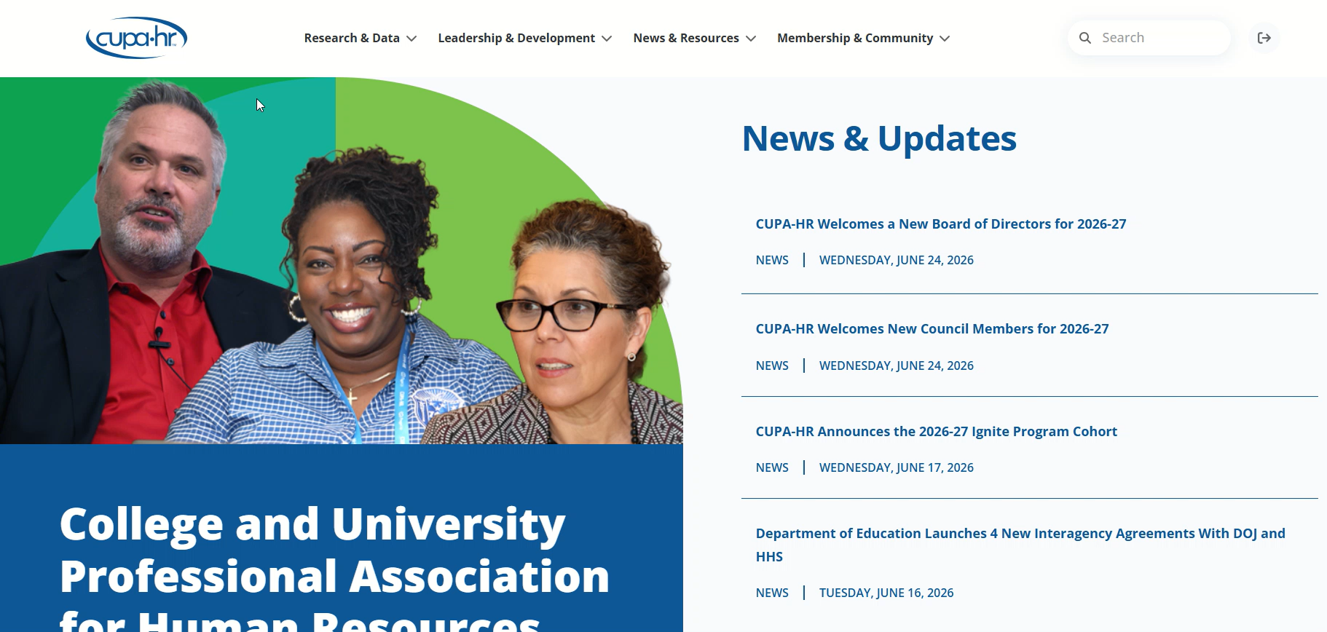
The Framework Site: Where Is It?
Notes:
[1 minute]
[NOTE: This slide contains a video – please click to play]
To find the learning framework, visit the main CUPA-HR site at www.cupahr.org, and click on Leadership and Development at the top of the site. From there, click on Learning Framework to navigate to the framework home page.
[time permitting, access via the CUPA-HR main site or the framework direct url https://www.cupahr.org/leadership-development/learning-framework/ ].
Now let’s take a look at the different elements that make the Learning Framework up.
[NEXT SLIDE]

Slide 9
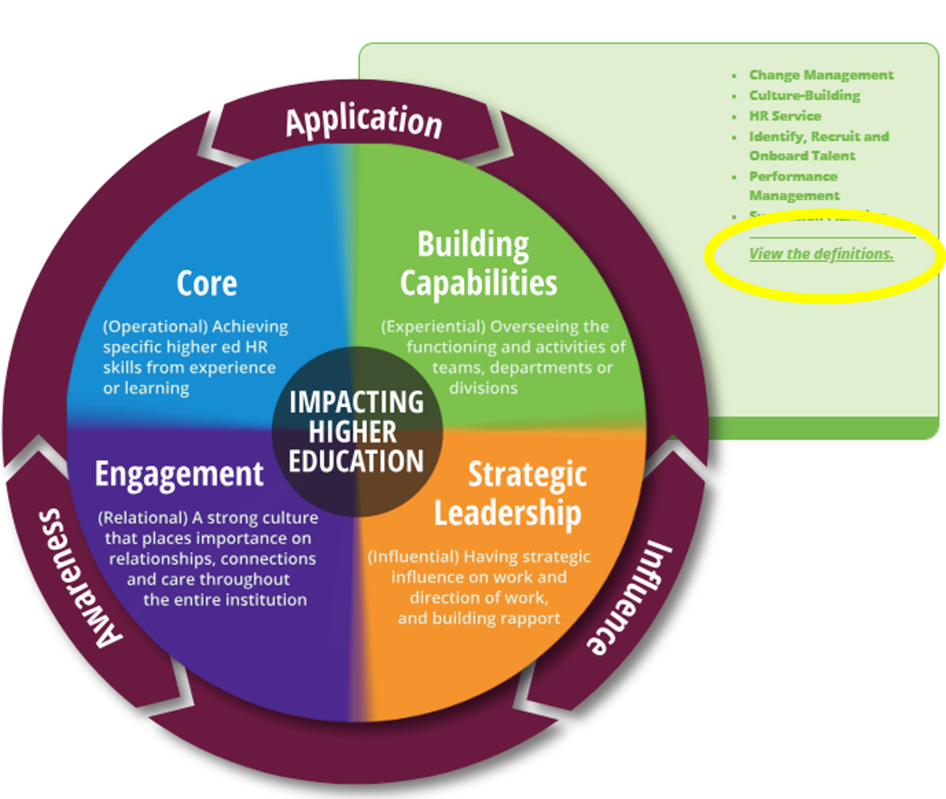
The Framework Site: Framework Graphic
Notes:
[30 seconds]
The main Framework graphic is interactive. Clicking on any of the Framework Main Areas will display a list of that area’s competencies and
[Click to highlight “view the definitions”]
an option to view the definitions, which will take you to that main area’s competency page.

Slide 10
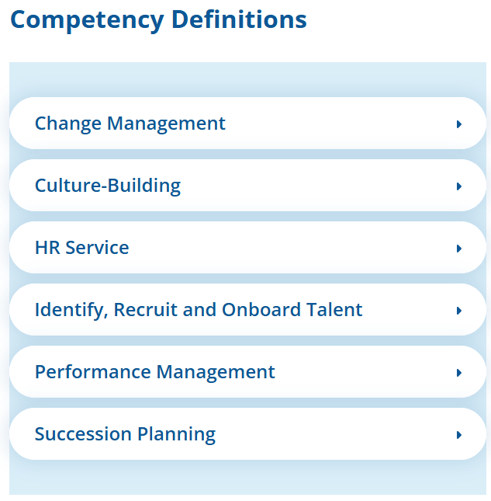
The Framework Site: Exploring Competencies
Definition
In Action
Assessment Questions
Leadership Lenses
Notes:
[1 minute]
On the Framework area competency pages, you’ll find in-depth information about each competency listed for that area. Each competency includes a definition of that competency, “In Action” examples of what the competency can look like in day-to-day HR functions, and Assessment Questions that you can use to gauge your or a candidate’s level of proficiency in a particular competency.
Some competencies will have Leadership Lenses as an additional feature. These Leadership Lenses explore how the competency may manifest as leadership focused skills and abilities.
[NEXT SLIDE]

Slide 11
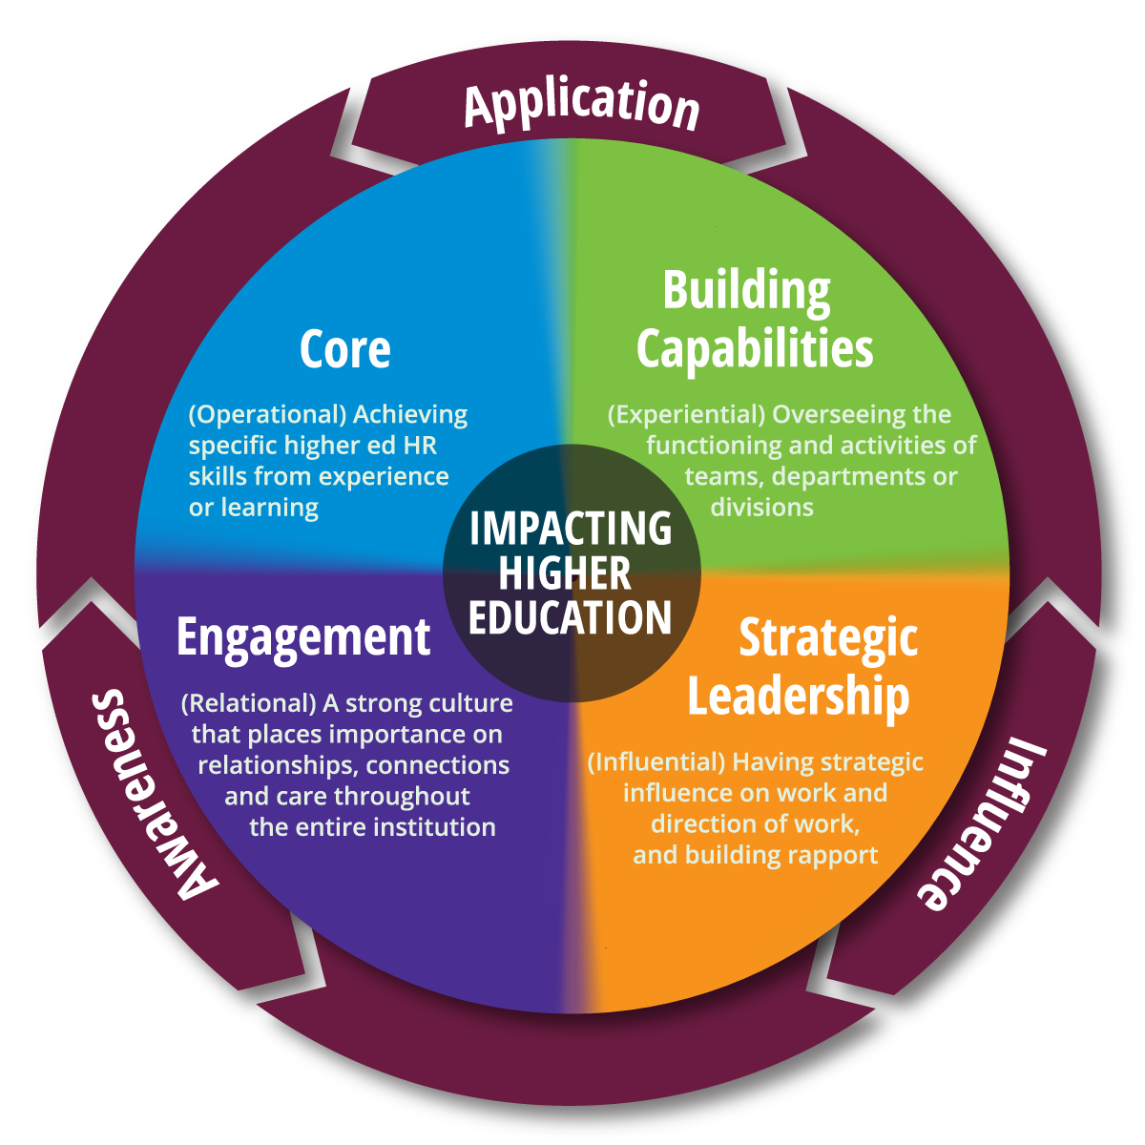
Ways to Use the Learning Framework
Notes:
[2 minutes]
At its heart, the learning framework illustrates specific competencies that are important to achieve our work in higher ed human resources.
That means it’s as important to consider our extraordinary ability to do the daily grind, as it is to illustrate who we are as trusted colleagues and influential campus professionals.
Therefore, the framework can help set professional goals for individuals and teams by:
Showcasing competency strengths;
Guiding discussion when determining which development areas should be of primary focus; and
Working with others to discuss the importance of competency development
To use the framework effectively as an individual, you need to reflect on the competencies necessary to perform your role and the areas you want to nurture.
Leaders can use the framework to assess the competencies that are critical to individual and team success. They can also use it to identify the levels of proficiency the team needs to achieve, find any development gaps, and discover ways to help everyone effectively develop.
[NEXT SLIDE]

Slide 12
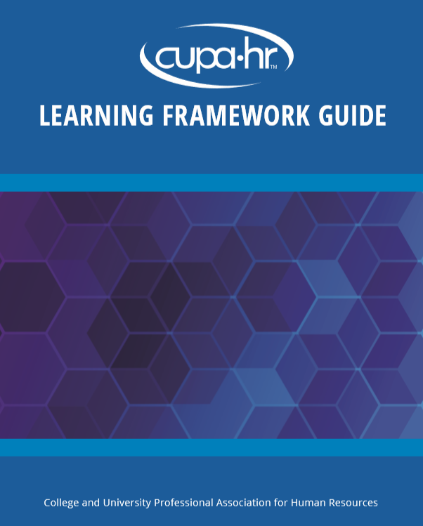

Individual Planning
Notes:
[2 minutes for covering the slide notes]
[About 3 minutes for responses/discussion]
The framework is designed to help individuals organize and target professional and personal development. Its primary purpose is to help reach short- and long-term goals, while strengthening current job performance. It's a structured approach to align learning activities to specific competencies. For example, individuals can set goals, then link to specific competencies they need to develop to help achieve the desired outcomes.
It is important to remember that many jobs may have an emphasis in only some parts of the framework. The Individual Action Planning guide will help to determine which areas are best to focus on for professional development, as well as assess how important each competency is to the individual and what level next to achieve. The rating mechanism helps to indicate an area where there is opportunity for growth.
Questions to the audience: What kind of development process or plan have you used in the past? How did it help? How do you see the CUPA-HR Learning Framework helping with future, individual development efforts? [allow a couple of minutes for them to share]
[NEXT SLIDE]

Slide 13
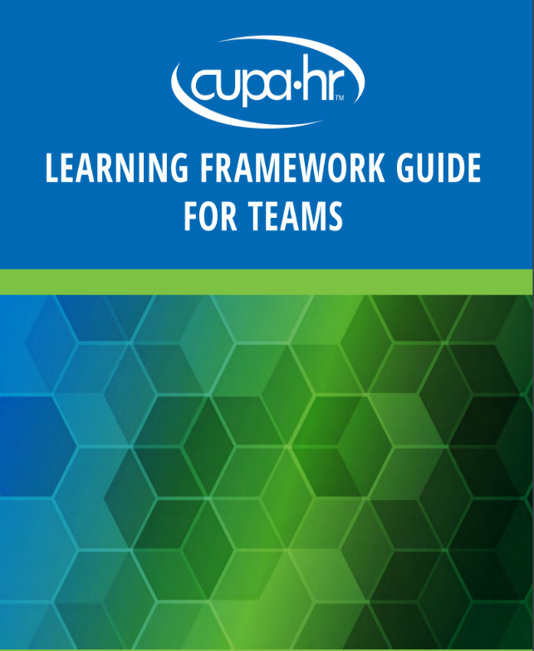
Team Planning
Notes:
[2 minutes for covering the slide notes]
[About 3 minutes for responses/discussion]
In terms of how the framework assists leaders with overall team assessment, remember good leadership begins with understanding how the team, working together, plays a critical role in the institution’s strategic success, building skills, building relationships, creating a welcoming environment, offering effective communication techniques, and more! These competencies are examples of what a leader wants everyone to learn more about. A great leader will be there every step of the way and recognize it’s about development and not about keeping score or notes for a performance evaluation.
Leaders can use the Team Action Planning Guide to help identify individual and team priorities for professional development and to identify team skill gaps that can help determine the best configuration of skills for your team. Also, ask your team to share from the framework which competencies will be the most important for the team one year, 5 years and 10 years from now.
Questions to the audience: What have you found to be the best method to determine team strengths and opportunities? How can the learning framework help to enhance those efforts? [allow a couple of minutes for them to share]
[NEXT SLIDE]

Slide 14

Leader Development
Notes:
[2 minutes for covering the slide notes]
[About 3 minutes for responses/discussion]
Finally, HR leaders must not forget to invest in themselves to maintain their proficiency in the areas of HR that matter to themselves and to the institution.
What must leaders do to be better equipped – mentally and professionally in order to deliver positive results?
Who do these leaders reach out to in order to practice and receive helpful feedback?
Be sure to take time out to develop an action plan for yourself!
In what ways have you held yourself accountable to take-action – don’t be someone, who puts themselves last on the “to do list!”
[NEXT SLIDE]

Slide 15
Thank You!
Name
Email address

