Slide 1

CUPA-HR Update
Spring 2026
CUPA-HR Leader Name
Title
Institution
CUPA-HR Leadership Role
Notes:
It is so great to join you today! Special thanks to the _____ Chapter board for planning this meeting and bringing you together. It’s so important for us to engage and connect, and I’m glad you are gathered to learn and share with each other.
We are certainly living through unprecedented times (again). We are adjusting and adapting to a flurry of executive orders, and campuses across the country are grappling with cuts in federal funding and enrollment declines that could potentially redefine and restructure higher education. And pending congressional budget actions could further impact the resources available to support student programs and resources. We have faced extraordinary challenges, and we know that more lie ahead for you, your institutions and CUPA-HR.
With your guidance and support, we are diligently working to adjust and adapt while doing our best to stay true to CUPA-HR’s values. Our values — community and belonging, innovation, service excellence, and integrity — clearly drive our work every day.
With all of this in mind, I am pleased to let you know that last year was another extraordinary year for CUPA-HR and that we are very excited about the year ahead.
Here are some quick CUPA-HR updates and information regarding the great work ahead of us this year.

Slide 2
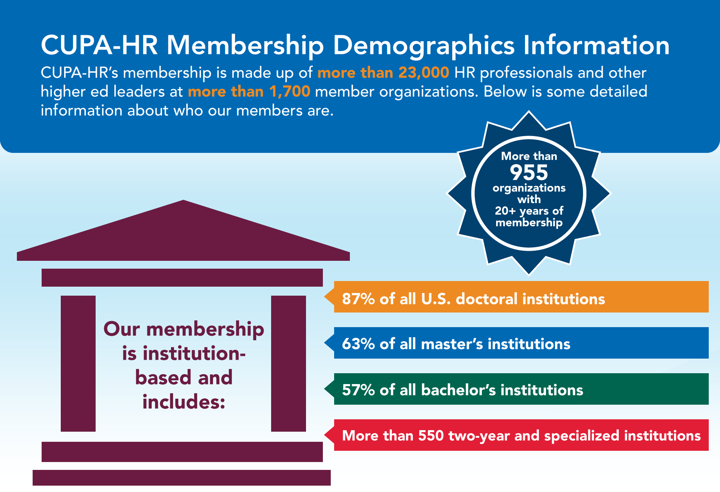
Notes:
I hope all of you know that CUPA-HR is higher ed HR!
CUPA-HR’s membership is made up of more than 23,000 HR professionals and other higher ed leaders at more than 1,700 member organizations. Below is some detailed information about who our members are. More than 955 of our organizations have 20+ years of membership.
Our membership is institution-based and includes:
87% of all U.S. doctoral institutions
63% of all master’s institutions
57% of all bachelor’s institutions
More than 550 two-year and specialized institutions
We are also pleased that our membership includes a great mix of public and private institutions, with 50% representing public and 50% private institutions.

Slide 3
CUPA-HR Content and Communications Policy
CUPA-HR is a non-partisan, non-profit educational organization of HR professionals serving our nation’s institutions of higher education. All content and communications in this meeting are educational in nature. No content or communications in this meeting shall constitute legal advice or counsel, nor are any communications in this meeting intended to promote, nor should they be construed as, a partisan position on any issues discussed.
Notes:
I’m not going to read all the words on this slide, but there are a few things that I want to note before we get started.
CUPA-HR is non-partisan — we represent and support higher ed and the higher ed HR community.
I am not providing legal advice or counsel.
As we go through some of the information that I will share, it’s important to note that your work must be developed and implemented in collaboration with your general counsel.
You know these things, of course, but it is important for me to reiterate them.

Slide 4
CUPA-HR’s Strategic Priorities
Learning and Professional Development Resources
Federal Legislative and Regulatory Issues
Creating Inclusive Communities
Higher Ed Workforce Research, Analysis and Reporting Resources
Notes:
There is so much noise in our world. Like all of you in this room, higher ed HR professionals across the country are stretched with limited resources to do the work that is most important. For CUPA-HR, we diligently work to focus our efforts on the issues and challenges most important for higher ed HR and the higher ed workforce.
The ambitious and progressive work of CUPA-HR is grounded in our core values — community and belonging, innovation, service excellence and integrity. Our strategic priorities are to:
Create and deliver learning and development resources to enable excellence and success for higher ed HR professionals and their institutions.
Proactively influence legislative and regulatory issues that impact human resources, higher education and the higher education workforce.
Build and foster an inclusive community that connects and engages higher ed HR professionals with one another, with other leaders and with the work of the association.
Create and deliver research, analysis and reporting resources that are the benchmark for higher education.
Not listed on this slide, but also critically important are our association operations.
Here are a few highlights regarding recent and planned efforts related to each of the priorities. [transition to next slide]

Slide 5
Key Focus Areas
Leading in Times of Uncertainty
Higher Ed as an Employer of Choice
Employee Health and Well-Being
Just-in-Time Legal and Public Policy Updates and Resources
Effective Use of AI in HR
Notes:
While our work is driven by the strategic priorities I just shared, these are the key areas we are focused on creating content and resources around. These include a focus on leading during times of uncertainty, what it means for higher ed to be an employer of choice, employee health and well-being, just-in-time legal and public policy updates, and effective use of AI in HR.

Slide 6
Learning and Leadership Development
New Approach to Leadership Development and CUPA-HR Content
Annual and Spring Conferences
Webinars
CHRO Summits and CHRO Conversations
Chapter Programming
Notes:
Let’s begin with our first priority, Learning and Professional Development. A number of things have occurred over the last year.
New Approach to Leadership Development and CUPA-HR Content
At the September 2024 virtual meeting, the board supported CUPA-HR staff plans to build much more robust leadership development programs and resources for higher ed HR professionals and to restructure our approach to creating and curating content. In a very short amount of time, staff created our initial leadership development focus, identified our first group of Navigators to work with new higher ed CHROs, developed plans for a different approach to CHRO learning and engagement, including the launch of the new CHRO Conversations series, and made important changes to our content and communications approach.
We piloted the first module our new Career Growth Series in August, which will launch publicly this spring. We also just finished the pilot of the second module in late January and early February. We are also creating a new leadership development program that will help prepare higher ed HR professionals to lead across the institution. You’ll see more regarding this new program in the fall.
Annual and Spring Conferences
The 2025 Annual Conference in Colorado was one of our largest ever with over 1,400 attendees, and we also celebrate that 96% of attendees rated the overall conference value as excellent/good. The Spring Conference in Seattle was among our highest-attended spring conferences with 535 attendees. 98% of the attendees rated the overall conference value as excellent/good. We look forward to the 2026 Spring Conference in Louisville, Kentucky, and the 2026 Annual Conference in Philadelphia this October.
[continued]

Slide 7
Learning and Leadership Development
New Approach to Leadership Development and CUPA-HR Content
Annual and Spring Conferences
Webinars
CHRO Summits and CHRO Conversations
Chapter Programming
Notes:
Webinars
CUPA-HR webinars are free to members (which includes anyone on your campus) and provide important guidance and resources to help us lead and manage our challenging higher ed HR roles and responsibilities. Thousands of higher ed professionals attended one or more of our 22 webinars last year. 95% of attendees shared they were satisfied or very satisfied with the content, and 96% said they would use the content. These ratings are outstanding and affirm our work to select presenters and topics and help them prepare to deliver the content.
The in-person CHRO Summit was a great success, with 94% of attendees sharing they were very or extremely satisfied with the content. We have also implemented a CHRO Conversations series that began this past fall and has had great participation and engagement thus far!
Chapter Programming
We also celebrate the outstanding in-person and virtual learning and development opportunities implemented by our chapter leaders from across the country. Chapter leaders are the conduit that connects us with higher ed HR professionals from early career to CHRO!

Slide 8

Legislative and Regulatory Issues
D.C.-based public policy team
Public policy alerts and news
Just-in-time webinars focused on policy updates and next actions for higher ed
Notes:
Moving to our second priority around Legislative and Regulatory Issues, we are so fortunate to have an outstanding D.C.-based public policy team led by our chief government relations officer, Josh Ulman. Josh has served as our chief government relations officer for the last 20 years. For our government relations team…and all of us…our work has been significantly impacted since January 2025. Since January of 2025, we have issued over 60 public policy alerts and new stories, hosted three just-in-time webinars, each with over 1,000 registrants, in addition to our regular bimonthly Washington Update webinars. These webinar and updates are a part of your CUPA-HR membership, and I hope you will take advantage of them.
Our team works to address current and emerging challenges and opportunities while trying to “prepare to be prepared” should issues currently on the back burner for Congress or the administration advance to issues of the moment that require immediate attention and action. Josh and his team also partner with other associations to advocate on behalf of higher education and the higher ed workforce. These partnerships help amplify our voice and demonstrate our commitment to supporting the entire higher ed community. So much accomplished, so much just-in-time work in collaboration with the entire CUPA-HR team, and so much work ahead of us.
I encourage you to pay attention to the CUPA-HR alerts and articles and review each week’s eNews, which is sent to members every Wednesday, for the latest updates and resources to help you adjust and adapt your policies and programs. Your president, provost and chief financial officer might not be aware of new and emerging labor and employment-related issues impacting the higher ed workforce. We encourage you to share CUPA-HR alerts and other updates with them to make sure these are on their radar.

Slide 9

Creating Inclusive Communities
Transition from Region Boards
New Chapter Support Council
New Member Engagement Council
Content to Help Navigate Ongoing Uncertainty
Connect and Engage Higher Ed HR Professionals
Notes:
On July 1, we transitioned from the region board governance structure that had existed for almost as long as CUPA-HR to Chapter Support and Member Engagement councils. We are excited about this significant transition to our work and so grateful to our region boards for their work and readiness to engage in a new direction for CUPA-HR. The councils have begun their work in earnest, and we are already seeing wonderful outcomes.
As CUPA-HR and higher ed HR leaders, we are committed to creating and sustaining inclusive, safe campus communities for all employees and students. CUPA-HR in-person and virtual programming includes keynotes and sessions to help higher ed leaders navigate ongoing uncertainty, and we will bring together groups, including new opportunities for CHROs, to share information and resources and create a strong sense of community and focus. We are also creating and curating content focused on civility, and building and supporting relationships with staff and faculty.
We will also continue our concerted efforts to connect and engage higher ed HR professionals with each other, with other leaders and with the work of the association. Making time for in-person and virtual connections, including this great opportunity to connect today and meaningful one-on-one and small-group connections throughout the year are important to your work and to your personal health and well-being.

Slide 10
Signature Surveys
Powerful DataOnDemand Tools
New Benefits Employee Experience and Structure (BEES) Survey
Updated and Reimagined Employee Retention Survey
Annual Workforce Data
Higher Ed Workforce Research
Notes:
Now for an update on our Higher Ed Workforce Research…
Signature Surveys
The number of incumbents included in the four signature surveys (Administrators, Professionals, Faculty and Staff) during the 2025-26 fiscal year is 961,223 — an increase from 922,755 the year prior – this is another record for CUPA-HR! We are also very pleased with the outstanding, consistent level of participation by higher ed institutions, with increases for the Professionals and Faculty surveys this year. There is no annual dataset like this, thanks to you and our colleagues across the country who submit data. And we appreciate those of you who use our very powerful DataOnDemand tools to create comparison groups to review compensation, workforce demographics and workforce size — in addition to hundreds of other possibilities to help you manage and lead your institution.
New — Benefits Employee Experience and Structure (BEES) Survey
During the 2024-25 fiscal year, we launched the new Benefits, Employee Experience and Structure Survey — including sections on flexible/remote work, well-being, and on certain reporting structures as well as some policies and practices of the institution. We just completed the second data collection which had good participation, and we look forward to greater participation as more higher ed HR leaders become aware of this excellent resource.
Updated and Reimagined Employee Retention Survey
We also celebrated the launch of the new Employee Retention Survey in April 2025 and the associated report in September. Not every institution can afford to bring in a big consulting firm to conduct an employee climate survey. We are pleased to offer this incredible new resource to campuses across the country. You can find this report on cupahr.org, and the link will be included at the end of this presentation.
[continued]

Slide 11
Signature Surveys
Powerful DataOnDemand Tools
New Benefits Employee Experience and Structure (BEES) Survey
Updated and Reimagined Employee Retention Survey
Annual Workforce Data
Higher Ed Workforce Research
Notes:
Annual Workforce Data
Throughout the year, our research team includes updates to the annual workforce data shared on the website. Recent updates include information on national median ratios for staff, faculty and students; adjunct faculty pay per credit hour; most frequently outsourced HR functions; flexible work; changes in workforce size; higher ed workforce turnover; and workforce pay increases. All are critically important data for us to use in our work! You can find these data on cupahr.org and the link will be included at the end of this presentation.

Slide 12

CUPA-HR Operations
New Association Management System
Employee Retention and New Team Members
New Website and AI Integration (www.cupahr.org)
Meet Cooper!
Notes:
Our association operations are the integral underpinnings for everything that we do. These encompass how we approach content and metrics, membership management and engagement, our conferences and events, our IT infrastructure, our overall finances, staffing and professional development.
In April we will celebrate two full years on our new Association Management System, or AMS. For those of you who have gone through large software implementations, you know how challenging not just the implementation can be but also the issues that pop up as you actually use the software on a daily basis. Needless to say, we navigated a lot, we are proud of where we currently stand. A tremendous thanks to our entire CUPA-HR team for their continued efforts in this process.
Speaking of CUPA-HR team members, I am also excited to share that we not only have 100% staff retention, but we added two new team members – in early 2025, Christy Williams joined the Communications and Marketing team as our new Content Manager. Rebecca Larson joined us as our new Associate Director of Leadership Development. As many of you know, CUPA-HR is a fully remote organization. Currently we have employees in 10 different states.
We also completed a significant website overhaul. This is not only a brand-new site, but also a new way of delivering content to our members. Our communications and marketing team worked hard on this project, and we have received a lot of positive feedback.
[continued]

Slide 13
CUPA-HR Operations
New Association Management System
Employee Retention and New Team Members
New Website and AI Integration (www.cupahr.org)
Meet Cooper!
Notes:
Related to this, in early 2025, we began some very focused efforts on AI and its application not only for our association staff, but also for our members and their institutions. AI, as we have already begun to see, is being called the greatest workforce disruptor since the Industrial Revolution. The disruption isn’t so much about an individual being replaced by AI as it is about an individual being replaced by another individual who knows how to use AI. Subsequently, this is and will continue to be an area of focus for CUPA-HR.
As part of this effort, we purchased an AI agent for our website to assist our members in finding the solutions they are seeking. We’ve named this agent Cooper, and you can interact with Cooper today! We’re very excited about this new tool and look forward to continuing to refine it as we move forward.
Finally, I’d like to extend my gratitude to the entire CUPA-HR team for all they did this past year and continue to do to make CUPA-HR what is for one another and for our members. This is truly a special organization, and I hope that each of you feel that as well. We are so fortunate, and I look forward to the year ahead!

Slide 14
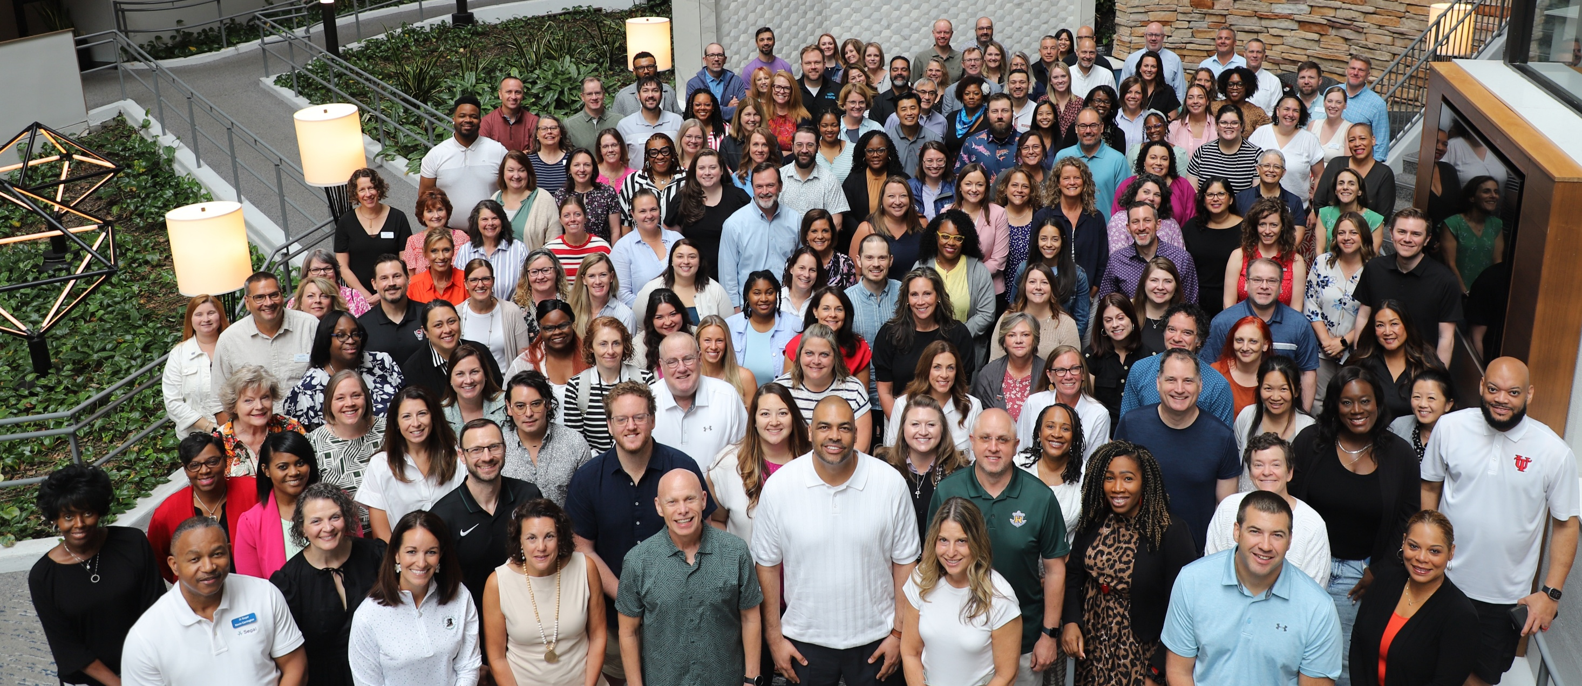
Your CUPA-HR Leaders 2025 Association Leadership Program
Notes:
These are challenging times for higher ed and higher ed HR, but you are making an impact every single day.
We higher ed HR professionals are a resilient bunch, and it’s so important for us to engage, connect with, and support each other. CUPA-HR is higher ed HR. This is our community.
I encourage you to make the most of your time here today and to make sure you leave with contact information for several of the HR colleagues you meet here.
Also, if you aren’t already on your institution’s CUPA-HR roster, please go to the website and add yourself. It’s easy and you shouldn’t be missing out on the frequent updates and access to resources created for higher ed HR.

Slide 15

Resources
CUPA-HR Advocacy Positions
Washington Insider Alerts
CUPA-HR Employee Retention Survey
CUPA-HR Annual Workforce Data
Cooper
Notes:
Here are the resources I touched on today.

Slide 16
[Insert presenter name and email here]
Closing Comments
Notes:
If there is anything else I can share regarding the work of CUPA-HR, please just ask or send me an email. My email address is included on this slide.
Thanks for inviting me to join you today.

