Slide 1
Higher Ed Leadership Pipeline Challenges
Notes:
Another provost leaves after just three years — which by the way is the median tenure for provosts — and we open yet another search. We appoint an interim (probably the same person who served as interim during the last search), bring in another search firm, dust off the job description we used just a few years ago, and appoint another search committee. We conclude the search by selecting an external candidate. Surely that person will bring that extra spark that we just didn’t see in the internal candidates. Or maybe no one internally wanted the job.
This is just one challenge we have created by our lack of focus on not just succession planning, but sustainability and the ultimate impact of our colleges and universities. Frequent unplanned turnover is a problem for the entire organization, and it impacts our ability to gain momentum and make progress. On the other hand, our lack of planning for anticipated turnover as leaders approach retirement age is also a problem that must be addressed.
What are the demographics of the incumbents in campus leadership positions? What are the demographics of the incumbents in the positions that tend to be the pipeline for leadership positions within our associations? Following the quick tour, we will (in small groups) highlight some of our challenges and opportunities. We’ll then come back together as a large group to discuss these challenges and opportunities and what we, as CUPA-HR leaders can do support not just succession planning, but the sustainability and ultimate impact of our colleges and universities.
The 2019 CUPA-HR data collection included data from 1,244 institutions and 756,455 incumbents, including over 259,000 faculty by discipline and rank. 1,174 institutions provided data on 50,880 incumbents in 200 administrative positions and 1,113 institutions reported data on 240,895 incumbents in 387 professional positions. Let’s start our campus tour!
Let’s start with a quick review of the median age and length of service for our administrative leadership positions. Before we look at the median age and median length of service for the 50,880 incumbents in our administrators survey, who would like to guess the median age of these incumbents? How about median length of service in their current positions?

Slide 2
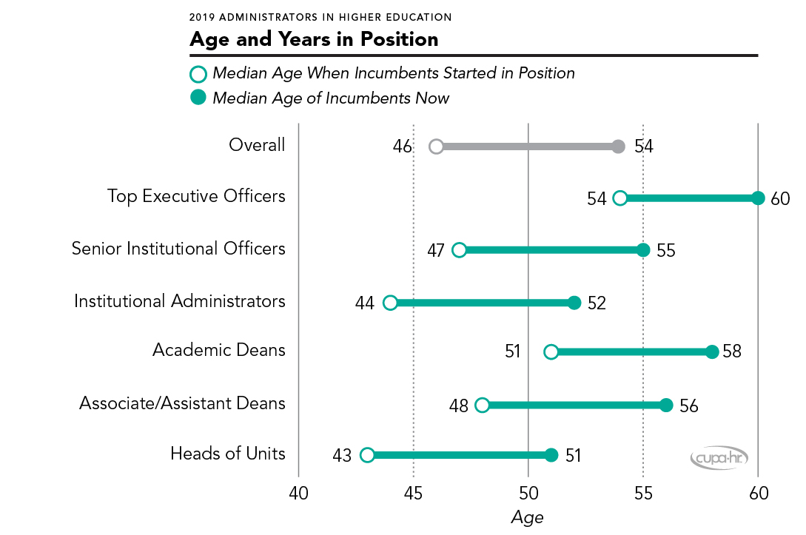
Notes:
Median Age and Length of Service
The answers are: median age if 54. Median length of service in current position is 8 years.
As indicated in this chart from the 2019 CUPA-HR Administrators in Higher Education Survey Report, the median age for every category of our campus leaders is greater than 50. [reference the chart and categories] These median ages in and of themselves are not necessarily challenges, but when we view them as part of our succession planning and the long-term sustainability of our institutions, a potential challenge quickly emerges.
If we highlight just one of the typical leadership pathways for higher education, an interesting and potentially challenging dilemma emerges:
Most of our current presidents, with a median age of 61, served in a provost role before serving as president. The median age of provosts is 59.
The majority of our provosts served as deans before serving as provost. The median age of deans is 58.
The typical pathway to dean is through an assistant or associate dean role. The median age of our assistant and associate deans is 56.
Also of importance is the length of time incumbents are spending in these roles. As noted in the chart, the median tenure of leaders in administrative roles is eight years, with very little variance by group. If this is similar for your institution, does this mean that there are not sufficient opportunities for advancement? Does it mean that the individuals in these roles have no interest in higher levels of responsibility?
While it is important to review these groups of leadership positions, it is absolutely critical to review specific roles within these leadership groups. The frequent turnover of our provosts is one example that has a tremendous impact on our institutions.
Let’s now look at the age and years of service for incumbents in the professional positions on our campuses. As I mentioned earlier, the professionals survey includes data on over 240,000 incumbents in 387 different position categories.

Slide 3
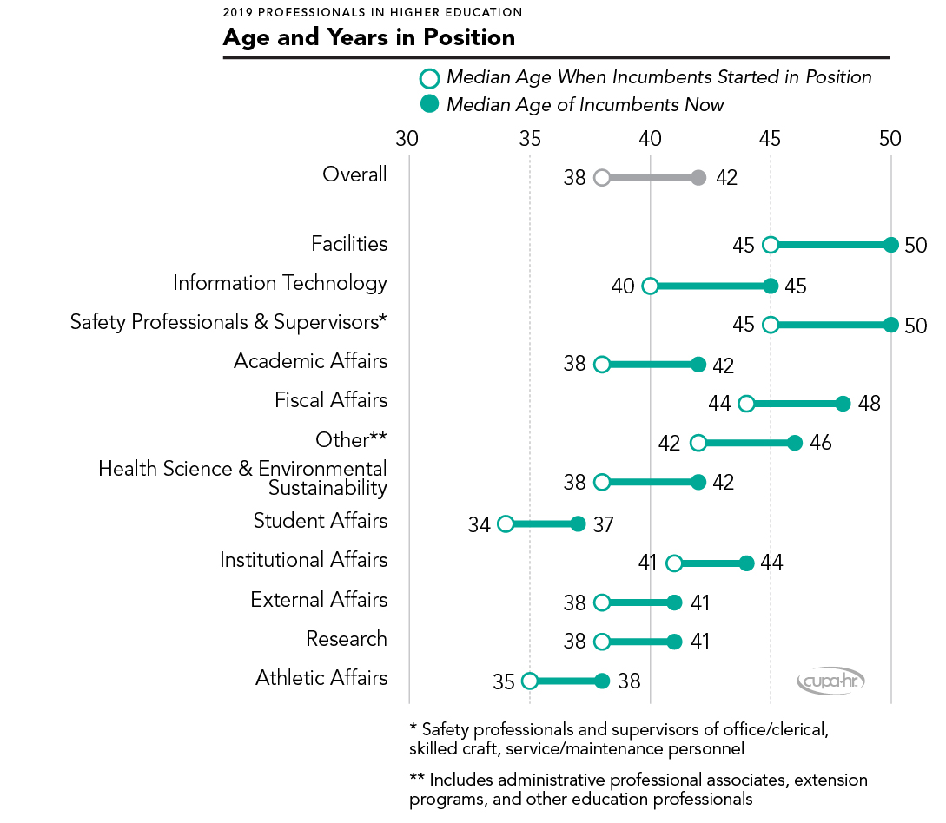
Notes:
Here is a similar chart from our professionals survey. Median age is 42 and median length of service in current position is 4 years.
Let’s take just a minute and look at the different position groupings [read them and comment you are happy to provide more detail about each category]. Many of our professional positions are leadership pipeline positions for the administrative leadership positions we just reviewed—examples include assistant director and manager positions and lots of positions with multiple incumbents (including many of our student life positions, accounting, IT, etc.) The good news here is that there are lots of incumbents in their 30s and 40s who could be the next incumbents of the admin leadership positions.
Let’s now switch from age and length of service to sex, race and ethnicity of our administrative positions.

Slide 4
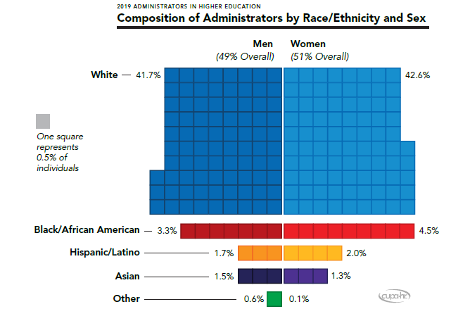
Notes:
[quick orientation to the chart]
Let’s now take a look at race/ethnicity and sex of our higher education administrators. So when we look at that group of 50,880 administrators, the good news is that women hold the majority (51%) of higher education administrative positions. But is it all good news regarding women in leadership roles? I’ll outline some of the challenges and opportunities in just a few minutes.
Over 84% of administrators are white.
Just less than 8% are Black/African American
Just less than 4% are Hispanic/Latino
Just less than 3% are Asian
For reference, in private industry, 87% of senior-level executives are White.
As our student population and the US population continues to become more diverse, there is a clear call to action here for higher ed.
Let’s now look at the next slide to see what type of administrative positions have the higher representation of women.

Slide 5
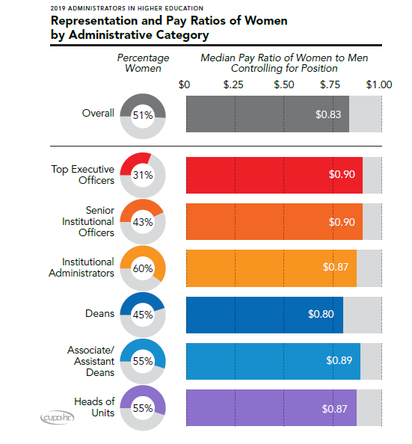
Notes:
For now, let’s just focus on the left side of this chart. Note the representation by different types of positions [reference them and the % of women in each]. What would this look like for your institution? There is clearly a pipeline for women to move to higher leadership roles, but as we know, this in and of itself does not mean that more women will be able to move to higher level roles.
We don’t have time to focus on pay equity during this presentation, but you will see that women are almost always paid less than their male counterparts. Anyone want to guess where women tend to be paid higher than their male counterparts? Positions that are predominantly held by men. If you are a woman who successfully persists to become a chief facilities officer or a chief information officer, you typically make more than your male counterparts.
Let’s take a look at minority representation in these administrative categories on the next slide.
The inclusion of demographic data for all of our surveys just three years ago has totally transformed what we are able to share regarding the higher ed workforce. It’s also totally transformed the tools available for you to analyze your workforce in comparison to your peer and aspirant institutions.
A total of 50,880 administrators were reported for this year’s survey.The 200 positions surveyed are grouped into six administrative categories:2
.Top Executive Officers--Includes Chief Executive Officer (Campus or System) and Executive Vice President/Vice Chancellor.
. Senior Institutional Officers--Persons in these positions direct a major functional area with institution-wide scope/impact as well as the work of other professional
employees.
. Academic Deans--Persons with faculty status who serve as the principal administrator/
head of an academic program, which may be a school, college, or
department.
. Institutional Administrators--Persons in these positions direct a major functional area with
institution-wide scope/impact as well as the work of other professional
employees. They serve as the senior content expert in a recognized
professional realm.
. Heads of Divisions, Departments, and Centers--Persons in these positions direct an institutionally recognized
division, department, or center and the work of other professional
employees.
. Academic Associate/Assistant Deans--Persons with or without faculty status who report to and support the
dean in the administration of an institutional program, which may be
a school, college, or department.

Slide 6
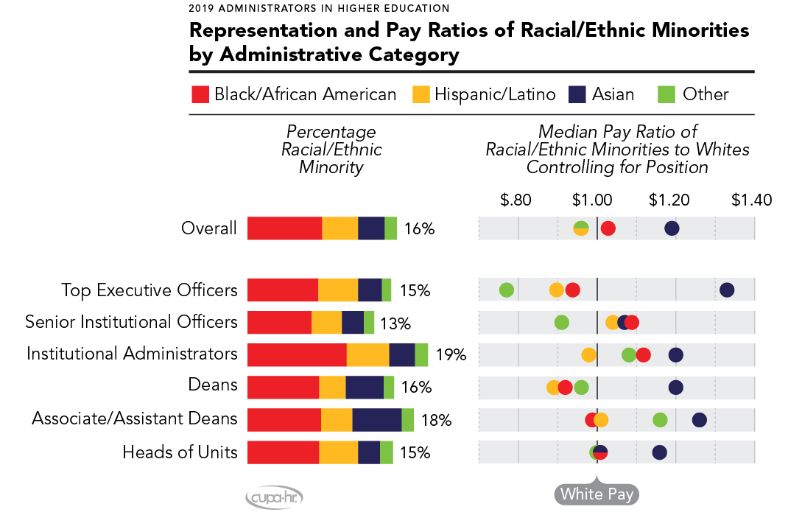
Notes:
Same categories from the previous slide. Let’s focus on the left side of this chart which shows representation of racial/ethnic minorities in each administrative category. Red is Black/African American, Yellow is Hispanic/Latino, Blue is Asian, and Green is Other (primarily Native American) , as well as pay ratios compared to White individuals. Minorities are best represented among institutional administrators (19%),and least represented among senior institutional officers (13%). For reference, 22% of all racial/ethnic minorities in the US have a bachelors degree. We include this 22% as a benchmark because we believe that if 22% of racial/ethnic minorities have a bachelor’s degree that our representation of racial/ethic minorities for our administrative and our professional positions (which we will review in a minute) should be at least 22%.
Again, we don’t have time to focus on pay equity, but note in the left side of the chart that OVERALL administrators from all racial/ethnic minority groups combined are better compensated than their White counterparts, with median pay ratios ranging from $1.01 to $1.11 per dollar paid to White administrators. However, this is due to the fact that Asian administrators are paid much higher salaries than any other ethnic group in nearly every administrative category. When the comparison is narrowed to people of color, Black and
Hispanic administrators are paid considerably lower among top executive officers ($0.94 and $0.89, respectively) and among deans ($0.92 and $0.89, respectively). Across all positions, Hispanic administrators are paid the least overall at $0.96 per dollar, and Asian administrators are paid the most at $1.19.
The “all minorities” racial/ethnic category collected in the survey includes the following groups based on the U.S. Census definition: Black/African American, Hispanic or Latino, Asian, Native of Hawaii or Pacific Islander, two or more ethnicities.
If our professional positions, those 240,000+ incumbents we referred to earlier, are our pipeline to bringing more women and minorities into leadership roles, are the incumbents in our professional positions more diverse than our administrative positions? What do you think? Yes or No?

Slide 7
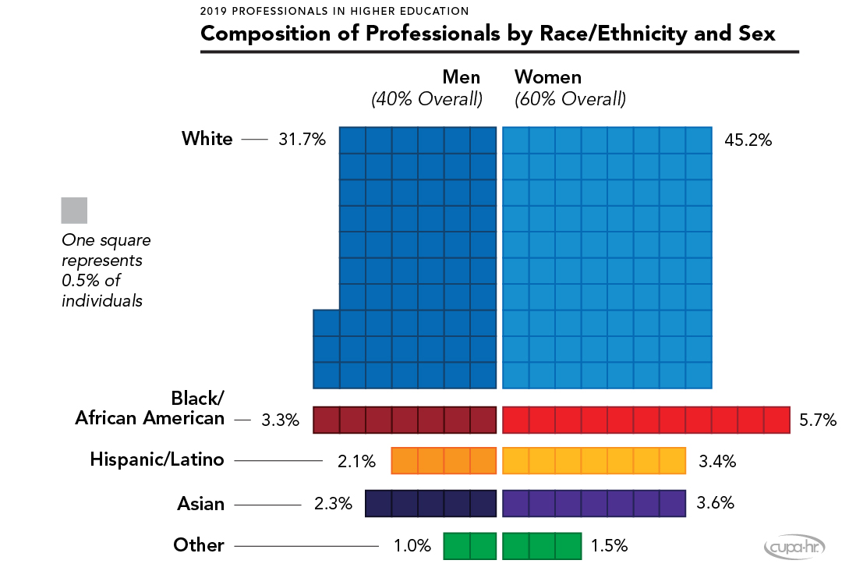
Notes:
77% white, 60% women (compared to 84% white for administrators and 51% women)—so less White professionals and more women
9% Black/African American (just 1% higher than administrators)
5.5% Hispanic/Latino (1.5% higher that administrators)
5.9% Asian vs 2.8 for administrators
2.5% Other vs 0.7 for administrators
Let’s now look at the different categories of professional positions—are there women in the pipeline for the different position categories?

Slide 8
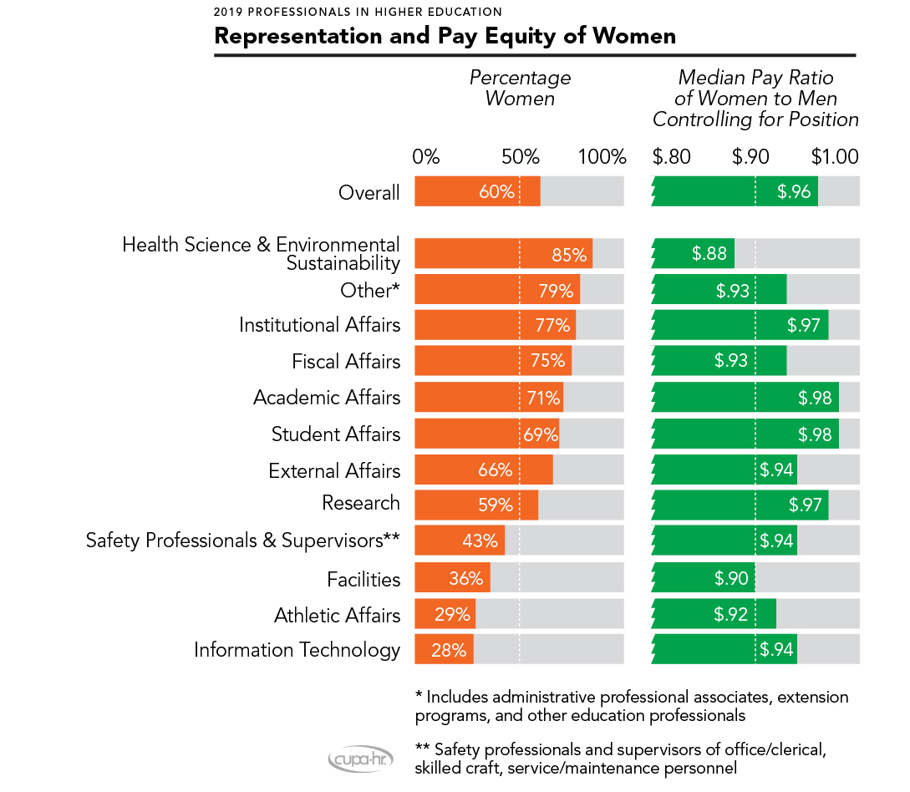
Notes:
[Reference the chart and that all but 4 are more than 50% female. Challenges continue in facilities, athletics and IT.]
Let’s now take a look at the pipeline for racial/ethnic minorities. Representation in our administrative positions is only 16%. Do we have a higher representation in our professional positions? Yes or No

Slide 9
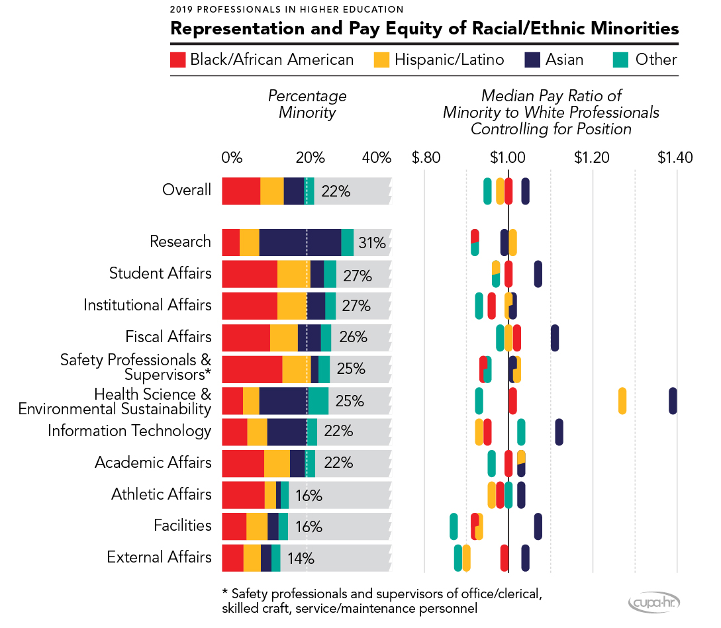
Notes:
The answer is Yes! Same colors from the previous chart—Red is Black/African American, Yellow is Hispanic/Latino, Blue is Asian, and Green is Other (primarily Native American) 22% of our professional colleagues are from a racial/ethnic minority. Also, remember from our prior conversation regarding administrative positions that our contention is that we should strive to have more than 22% of our administrators from a racial/ethnic minority? This is the good news. Now note the areas that are above 20%. You will note that athletics and facilities were two of the areas that also had low representation of women.
We don’t have time to focus on the pay equity, but I encourage you to review that information when you receive the presentation.

Slide 10
 | All Racial/ Ethnic Minority | Black & Hispanic | All Women | Black & Hispanic Women | White Women | White Men | Median Age
U.S. Population with B.A. Degree | 22% | 18% | 31% | 19% | 34% | 35%
All Administrative Positions | 15.7% | 11.6% | 51.2% | 6.5% | 42.6% | 41.7% | 54
All Professional Positions | 22.9% | 14.6% | 59.4% | 9.1% | 45.3% | 31.8% | 42
Selected Administrative Positions 2019 Administrators in Higher Education Survey
Chief Executive Officer, Single Institution or Campus within a System | 14.9% | 11.8% | 31.7% | 3.9% | 25.7% | 59.4% | 61
Chief Academic Affairs Officer/Provost | 12.3% | 8.3% | 43.6% | 4.0% | 38.1% | 49.6% | 59
Chief Business Officer | 8.3% | 5.7% | 32.4% | 2.3% | 29.4% | 62.3% | 56
Chief Human Resources Officer | 20.3% | 17.5% | 73.8% | 14.0% | 58.2% | 21.5% | 55
Chief Diversity Officer | 89.4% | 80.2% | 67.6% | 52.1% | 8.6% | 2.0% | 52
Selected Professional Positions 2019 Professionals in Higher Education Survey
Head, Student Disability Services | 18.2% | 13.9% | 76.4% | 11.4% | 62.2% | 19.6% | 49
Head, Campus Conferences | 7.6% | 2.7% | 71.9% | 2.7% | 65.4% | 27.0% | 47
Head, Student Success | 22.4% | 19.9% | 73.3% | 15.5% | 55.9% | 21.7% | 44
Notes:
ADMINISTRATOR select positions:
CEO has the highest median age, at 61.
Provost illustrates the nuanced differences in these data – less minority representation than CEO (12.3%) but much more representation of women (43.6%).
Chief Business Officer has the lowest overall representation of minorities at 8.3%.
CHRO has the highest overall representation of women at 73.8%.
Chief Diversity Officer has the highest overall representation of minorities (89.4%) and over half are black & Hispanic women (52.1%).
PROFESSIONAL select positions:
Head, Student Disability Services has highest representation of women (76.4%), but also strong representation of minority women (11.4%).
Head, Campus Conferences has lowest representation of minorities (7.6%) but very high representation of women – particularly white women (65.4%).
Head, Student Success has the highest representation of minorities (22.4%) and highest in particular for black & Hispanic women (15.5%).

Slide 11
Position Review Activity
15-20 minutes
As you verbally share the key findings from your leadership demographic and potential successors analysis for your respective institutions, what commonalities do you see across institutions? What differences?
Based on the commonalities and differences you identify; how would you frame the key leadership pipeline challenges we face in higher ed?
Based on the key challenges we just discussed, quickly brainstorm actions we should take as higher ed HR leaders and as CUPA-HR leaders to create more of a leadership pipeline and help more women and minorities move into campus leadership roles.

Slide 12
Follow-Up
10 minutes
How can we use this work with our region boards? Should we engage in a similar activity with them?
How can we use this work during future board meetings?
Other key take aways?

Slide 13
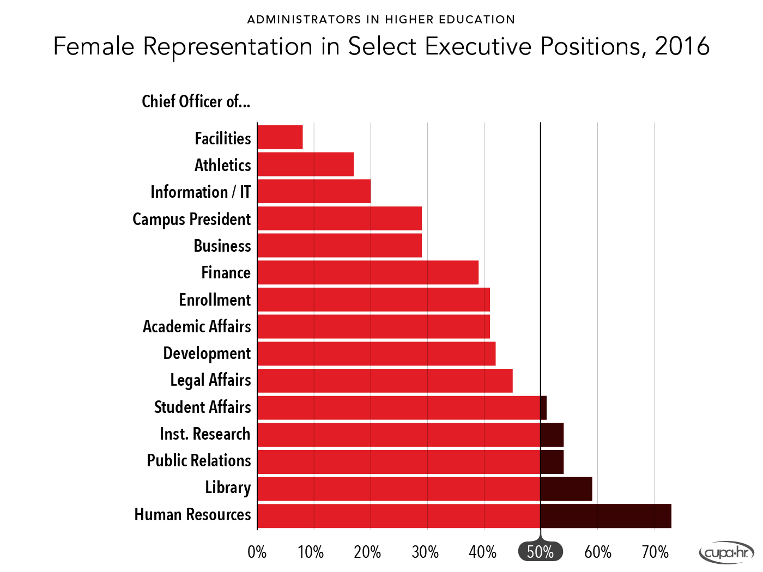
Notes:
Quick look at some of the specific key leadership positions. Over 70% of chief HR officers are women. Lowest representation in facilities, athletics and IT.

Slide 14
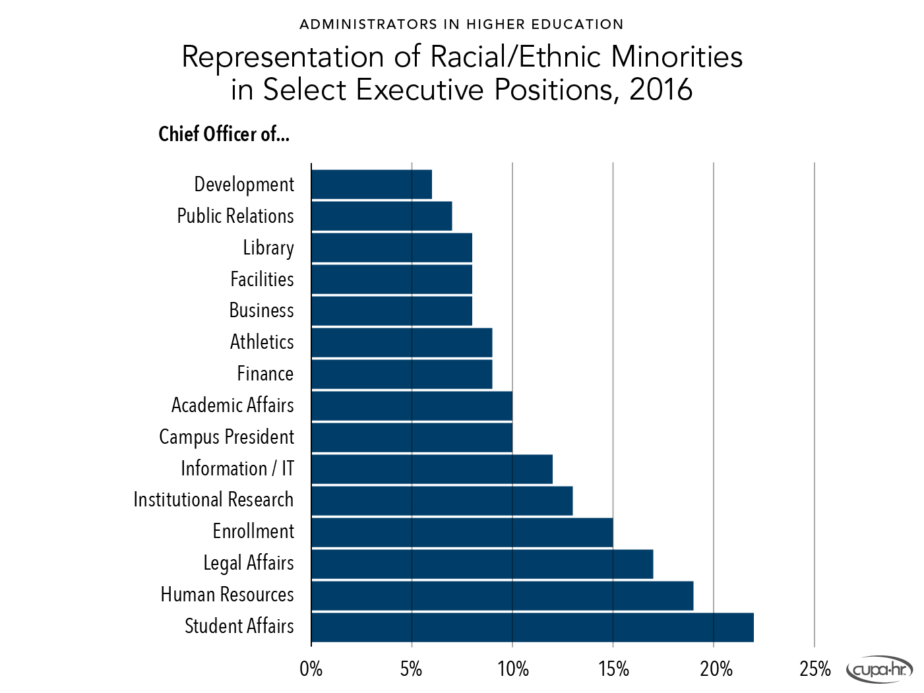
Notes:
Here’s a quick look at some of the specific key leadership positions. Over 90% of chief diversity officers are minorities.

